Slide 1
Partners in World Mission Webinar: Insights from Bangladesh and Japan
Church of Bangladesh
Presented by: Bishop Shourabh Pholia
And
Suchitra Behera
Date : 10th September 2020

Slide 2
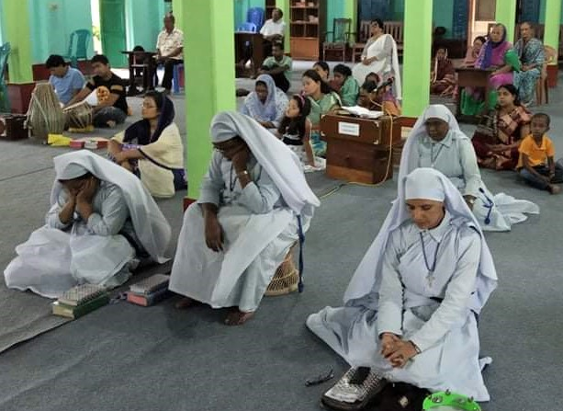
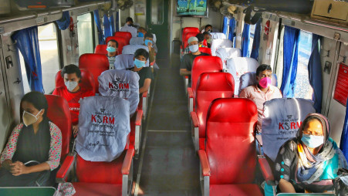
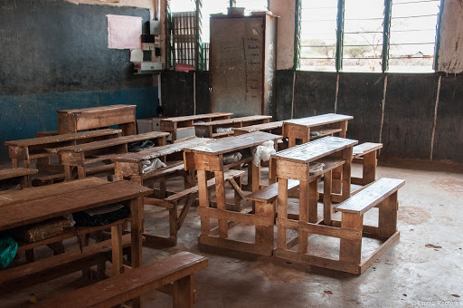
The current context of Bangladesh – the impact of COVID-19

Slide 3
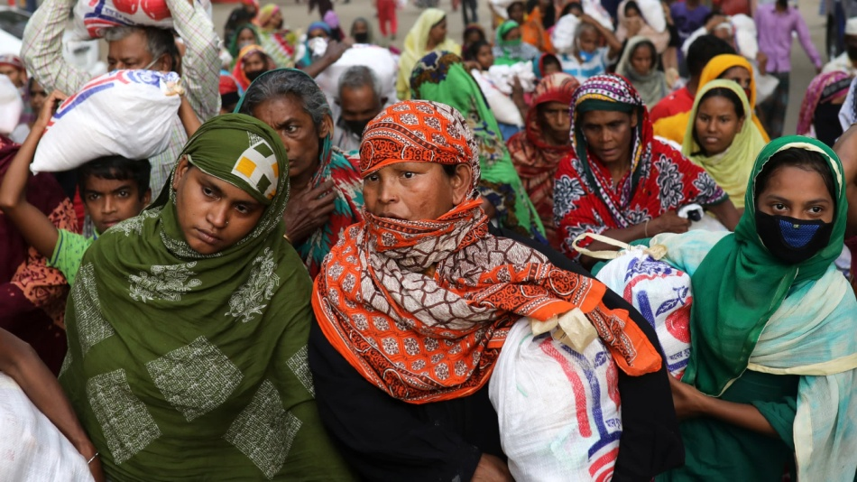
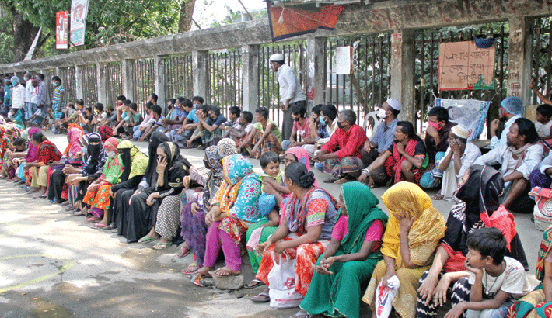
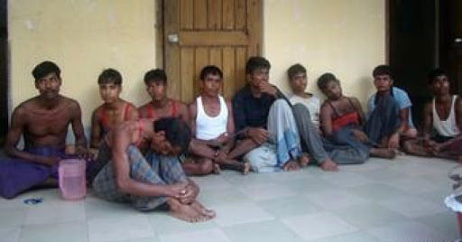
The current context of Bangladesh – the impact of COVID-19
91% of families financially unstable
70% experienced food insecurity
47% Earning drops below international poverty line
15% remained hungry
80% Unemployed as Business are closed.
Large numbers of people are migrating from cities to rural.

Slide 4
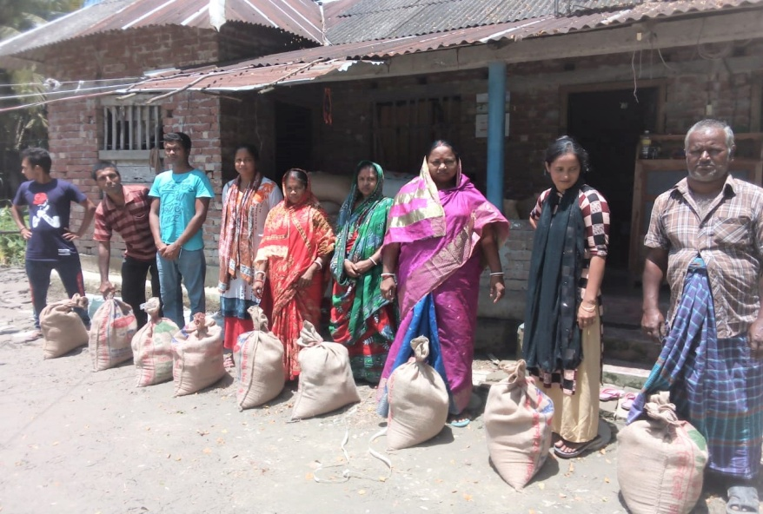
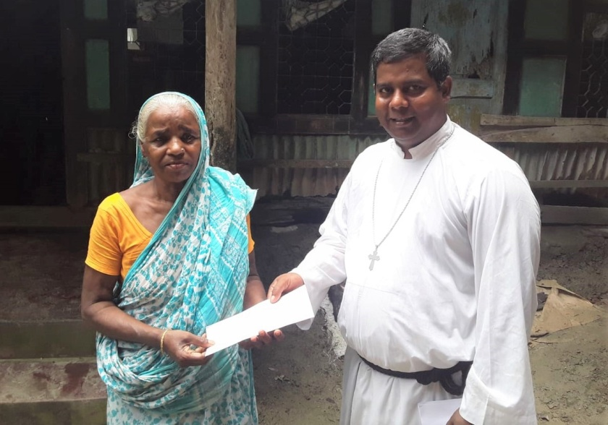
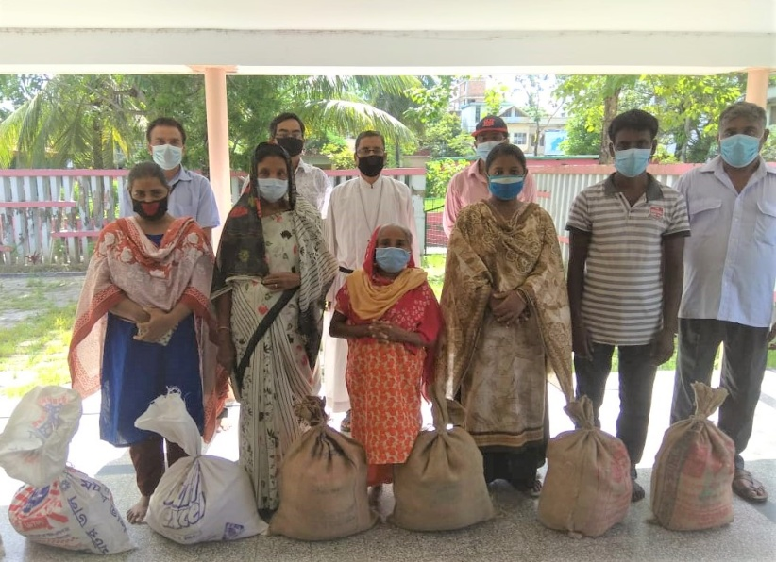
Church of Bangladesh response to COVID-19
The COB gave full attention towards the immediate needs of the people. As many have lost their jobs or not getting salaries, and many had to migrate from cities to rural area.
Methodist Church in Britain, CMS-Asia Desk and the Church of Scotland provided cash support and daily commodities almost for 3500 families in all over the COB and their neighbors.
Many local church members have come forward with their financial support to share with the fellow human being.

Slide 5
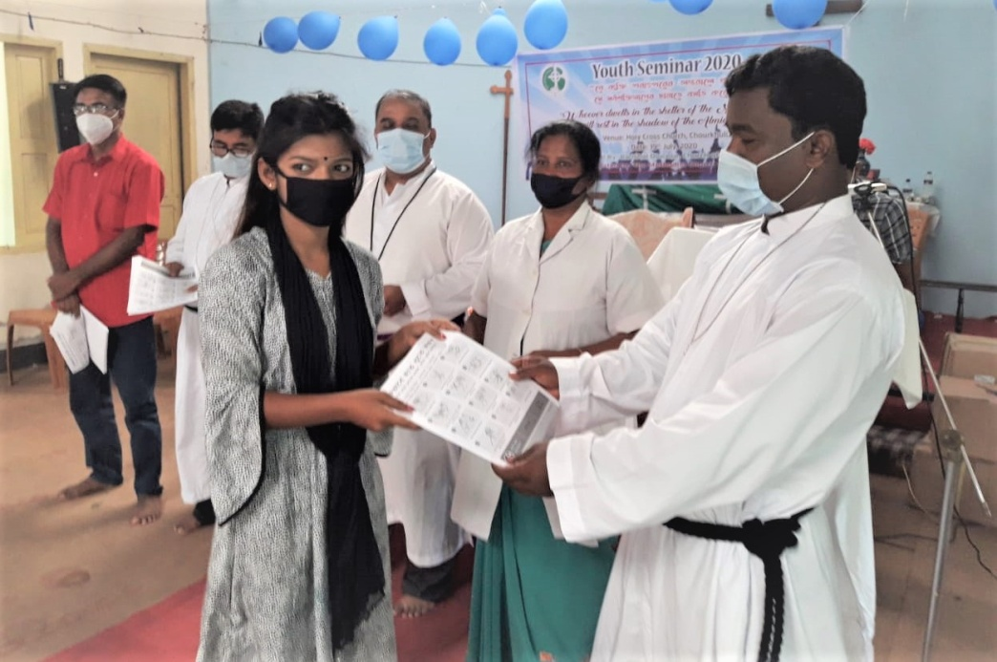
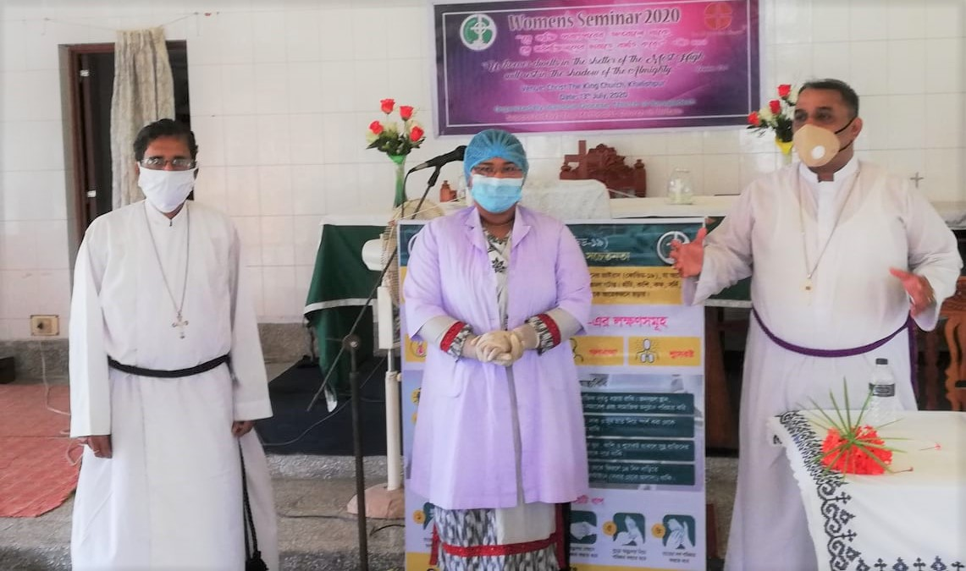
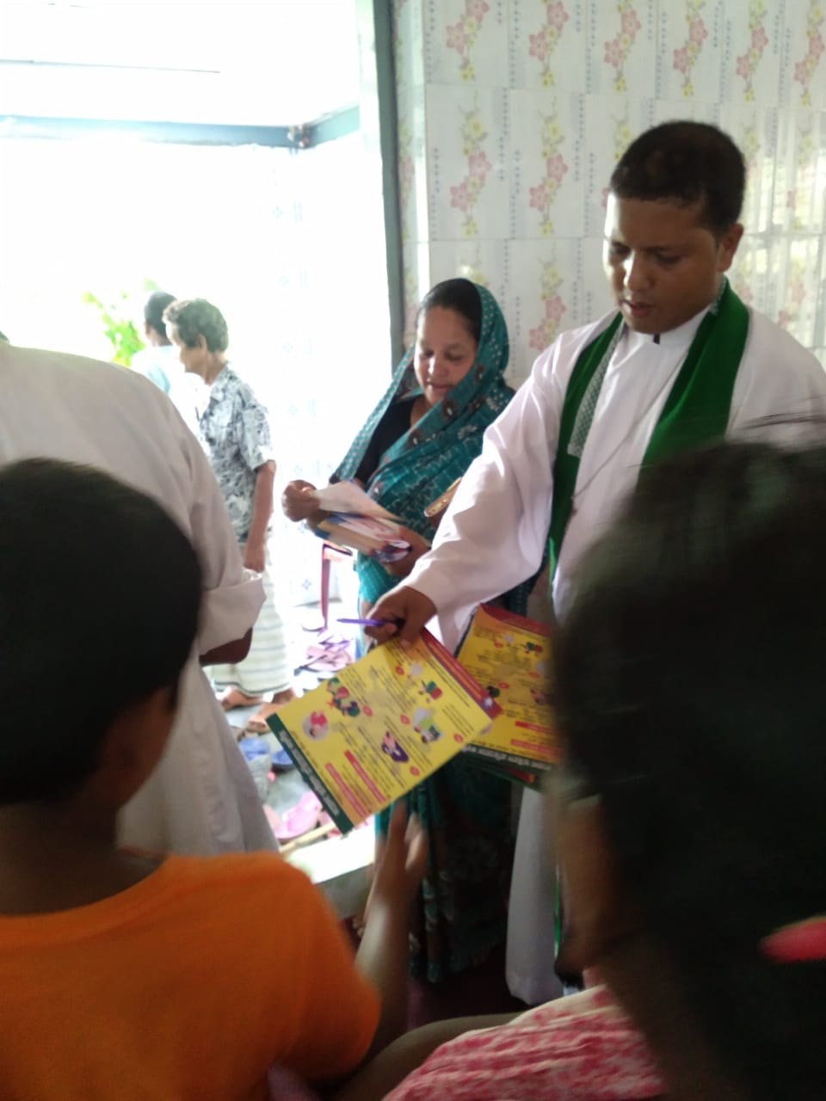
COB effectively used its 11 clinics in Dhaka and Barishal Diocese. These clinics efficiently aware people regarding COVID 19 and encouraged people to hand wash, use masks and how to maintain physical distancing.
We are obliged to USPG and ERD for supporting us to purchase materials and essential medicines for health awareness and protection. COB Central office reported 30,000 people were benefited directly and indirectly with this generous support.
The pulpit has been used to sensitized people about the prevention measures from COVID19

Slide 6
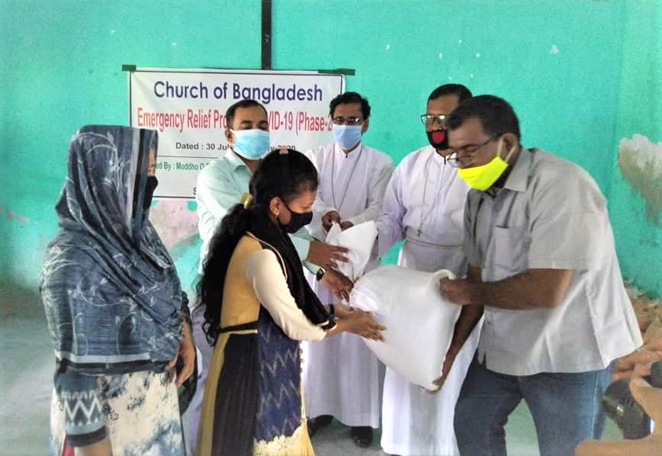
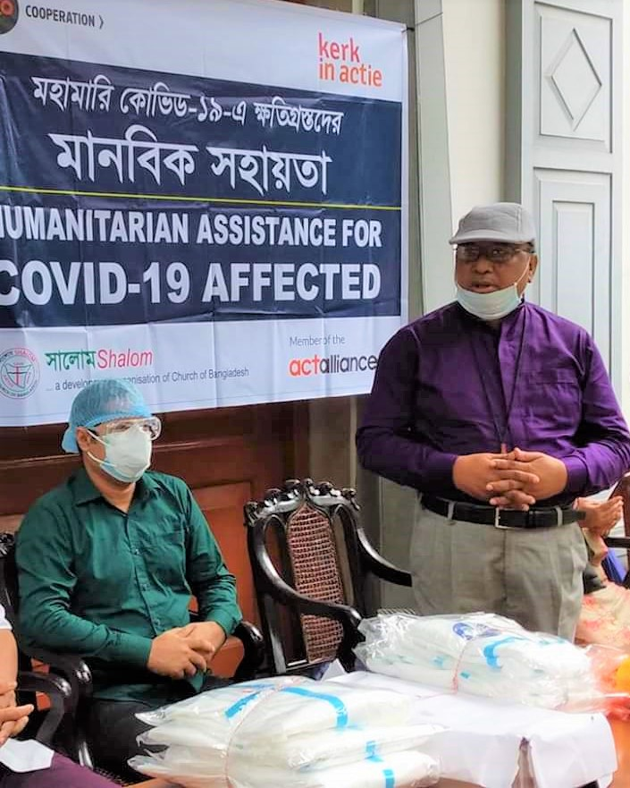
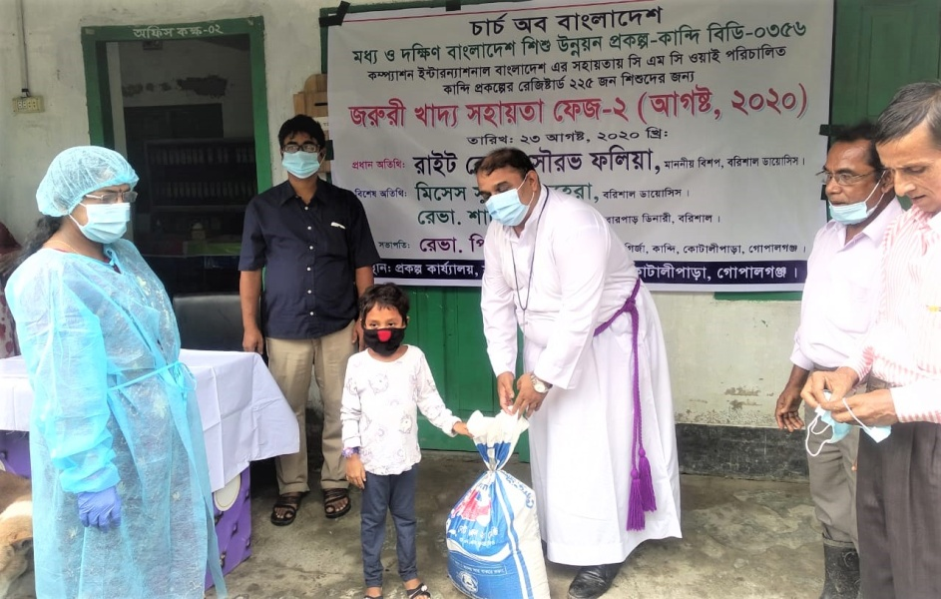
Through COB’s development wings SHALOM and CMCY have supported at least 10K people
with the kind support of their partners.
In all churches COB has established hand washing station to be safe.

Slide 7
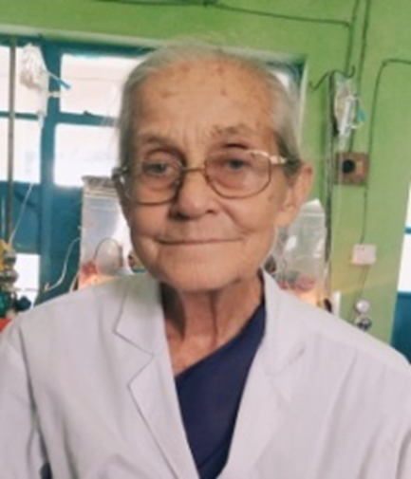
USPG Supported Response during COVID-19 in Bangladesh: Bollobhpur Hospital
Bollobhpur Hospital continuing its service to the needy and poor patients in their area.
No patients have been refused admission or treatment.
Nursing training continued by following the social distance and safety policy.
Sister Gillian M Rose, MBE, working hard and serving the community people devotedly.
They are serving the elderly people by keeping them in hospital and providing all kind of support to give them peace and comfort.
Sister Gillian M Rose

Slide 8
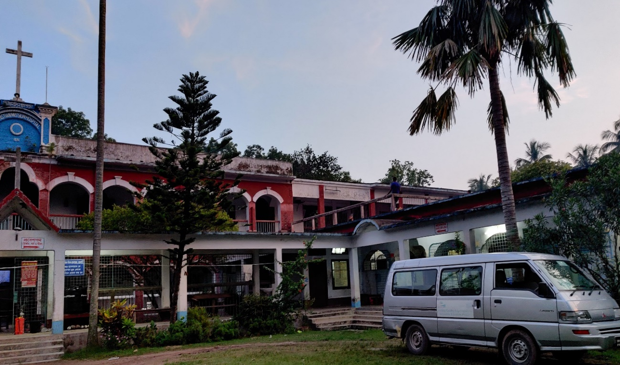
Christian Mission Hospital - Rajshahi
COB dedicated Christian Mission Hospital for Corona Patients treatment through government management. Many have been received treatment from this hospital with the help of Government of Bangladesh.
The Nursing Institute is closed now. Its 150 students are staying at their homes as all the educational institutions are closed as per Govt. instruction.
Only one Christian Hospital is dedicated for COVID-19 Treatment by the joint management of CMH-Raj and Government of Bangladesh

Slide 9
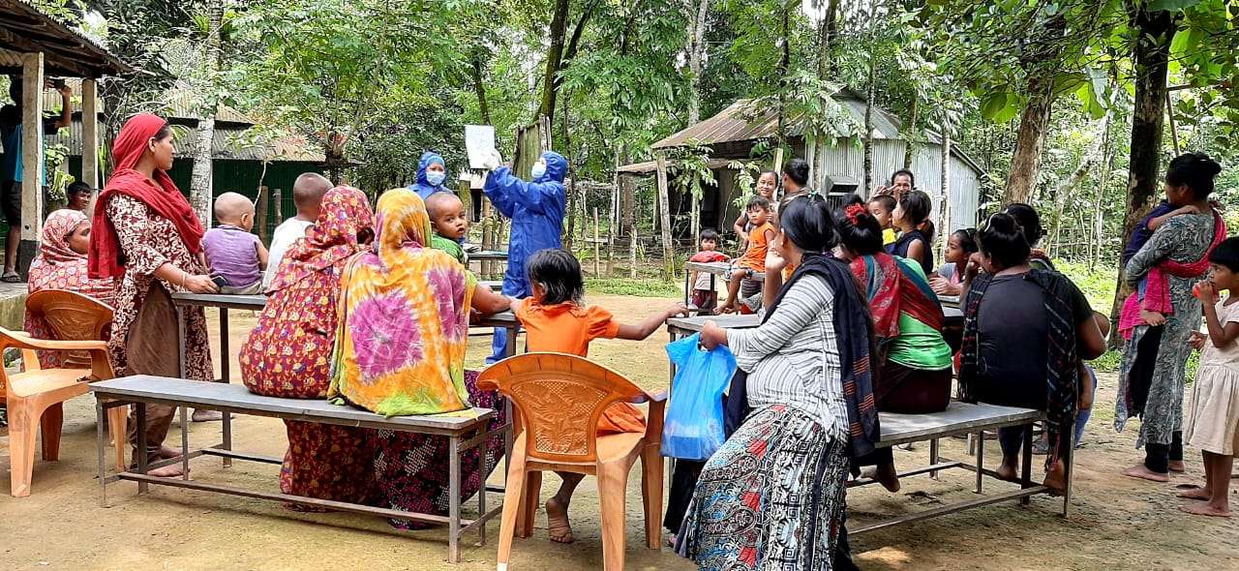
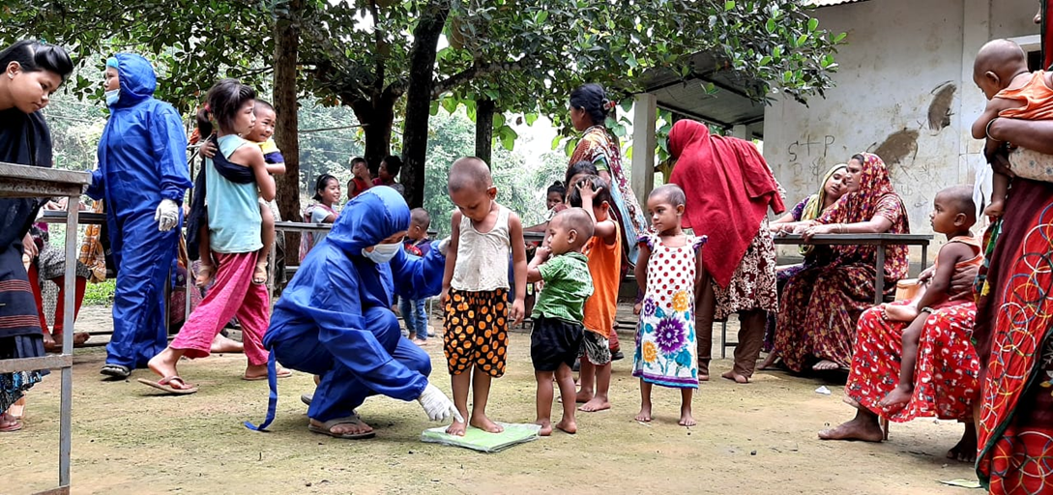
Community Based Clinic Health & Nutrition Program
CBCHNP started in 2020 in Dhaka & Barishal Diocese with 11 clinics. This project is supported by USPG.
Aiming to serve the neglected and deprived rural people.
55 staff are working even during this time of crisis. They have received PPE for personal safety while at work.
Though there is limited resources still all the nurses, health workers, support staffs, Synod and Diocese staff are working under the guidance of the respective Bishops.
Images of USPG supported Community Health Program in Baromari Rural Area

Slide 10
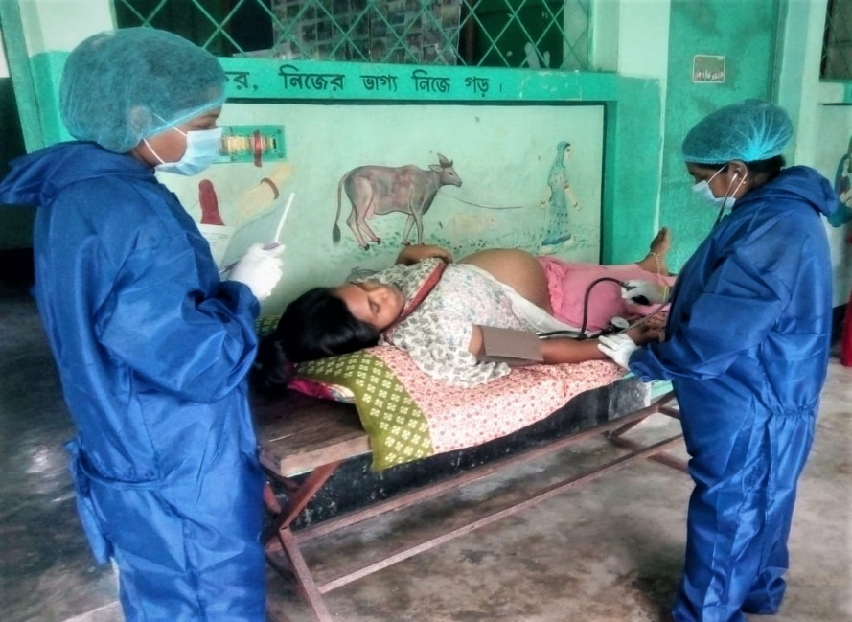
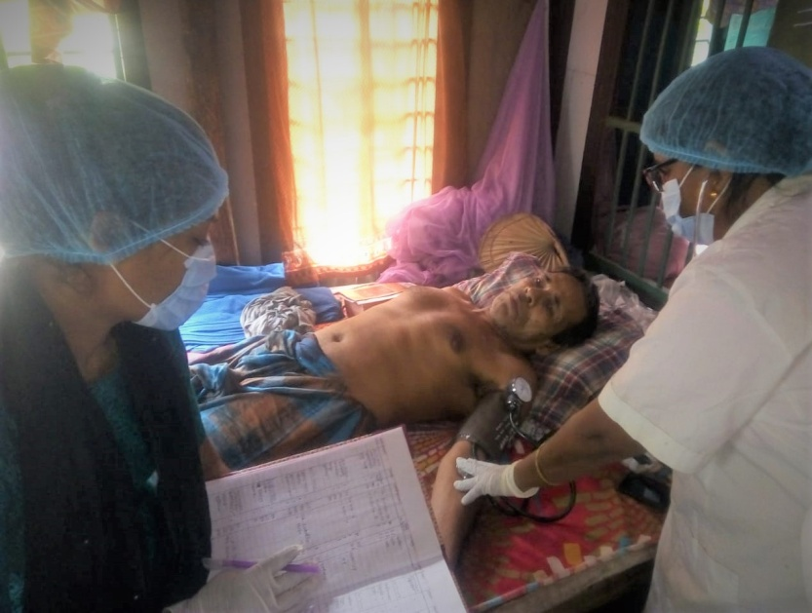
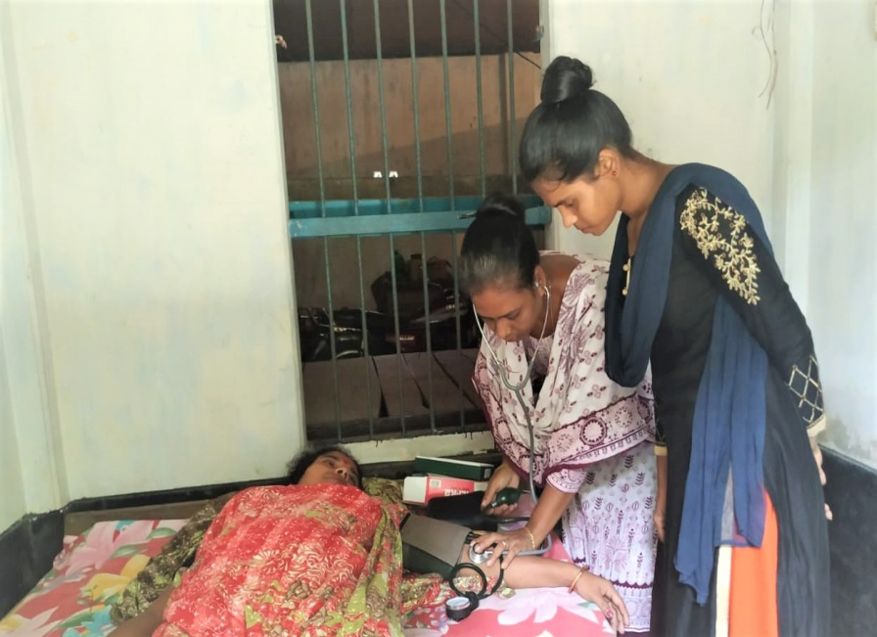
CBCHNP

Slide 11
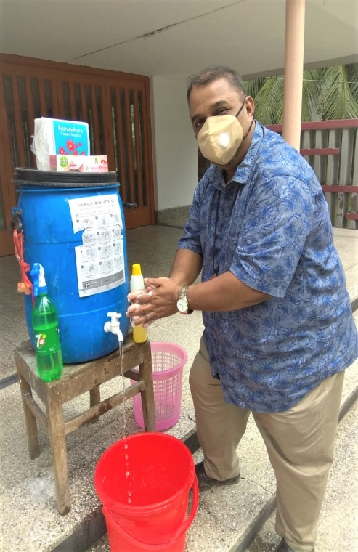
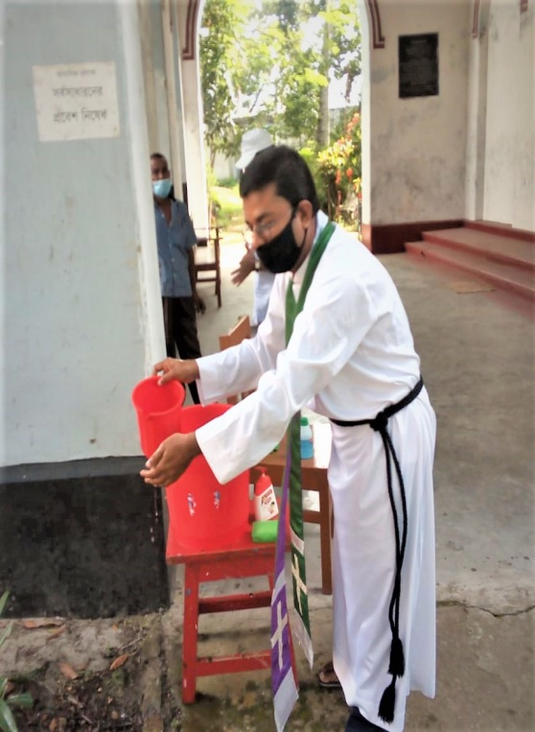
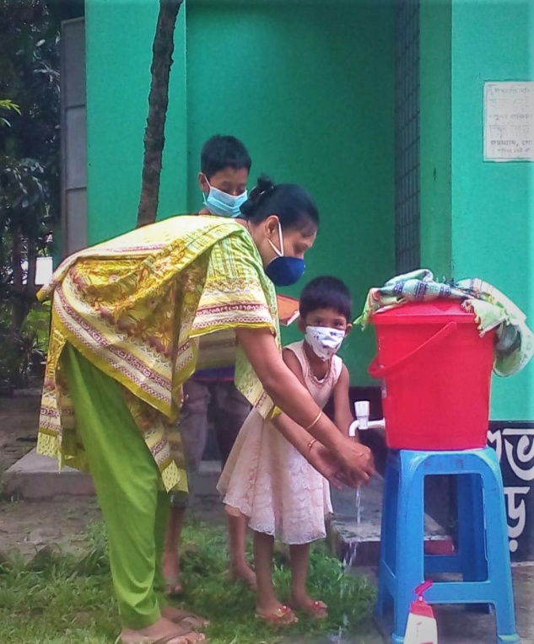
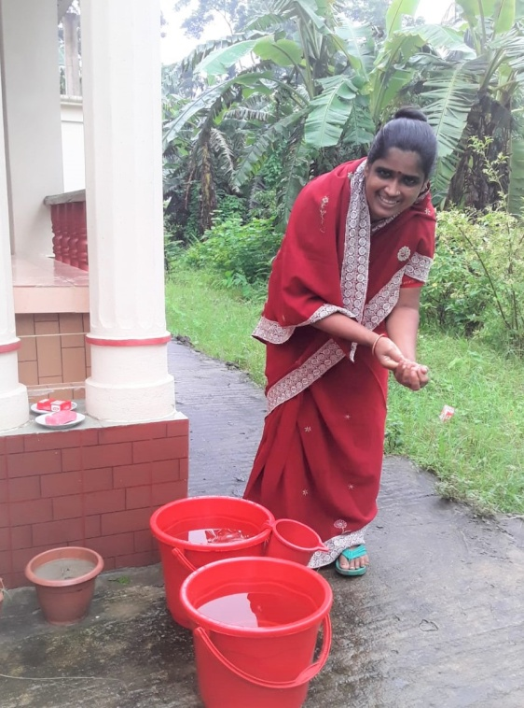
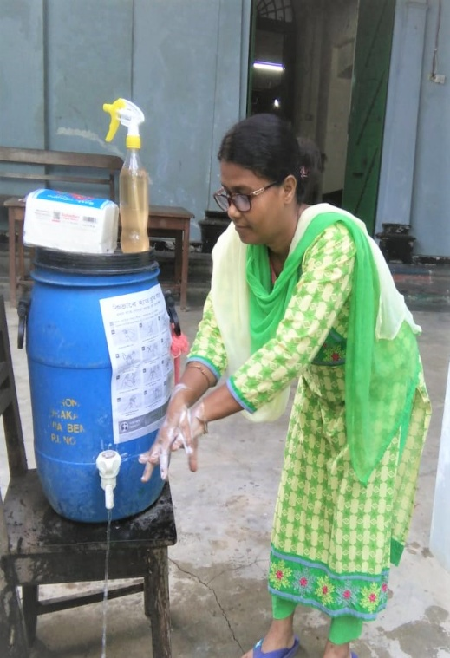
Community Based Clinic Health & Nutrition Program

Slide 12
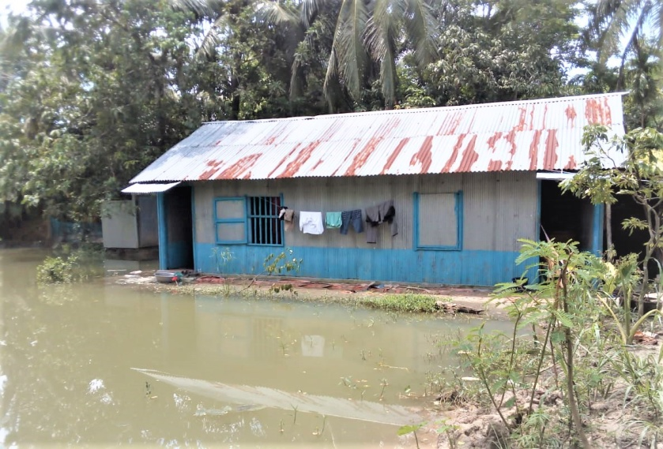
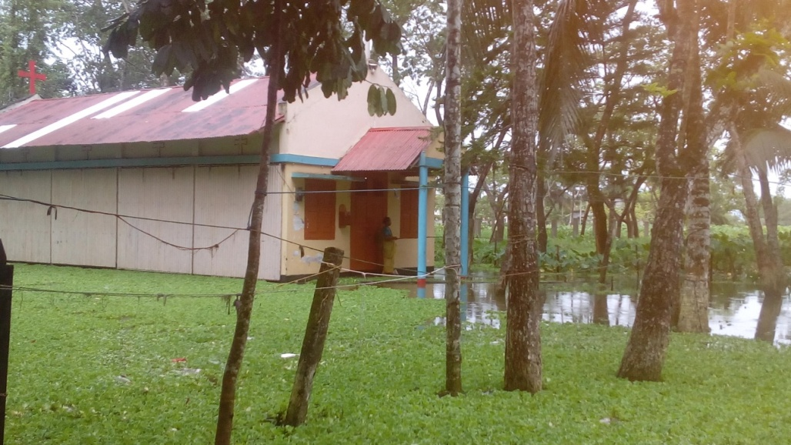
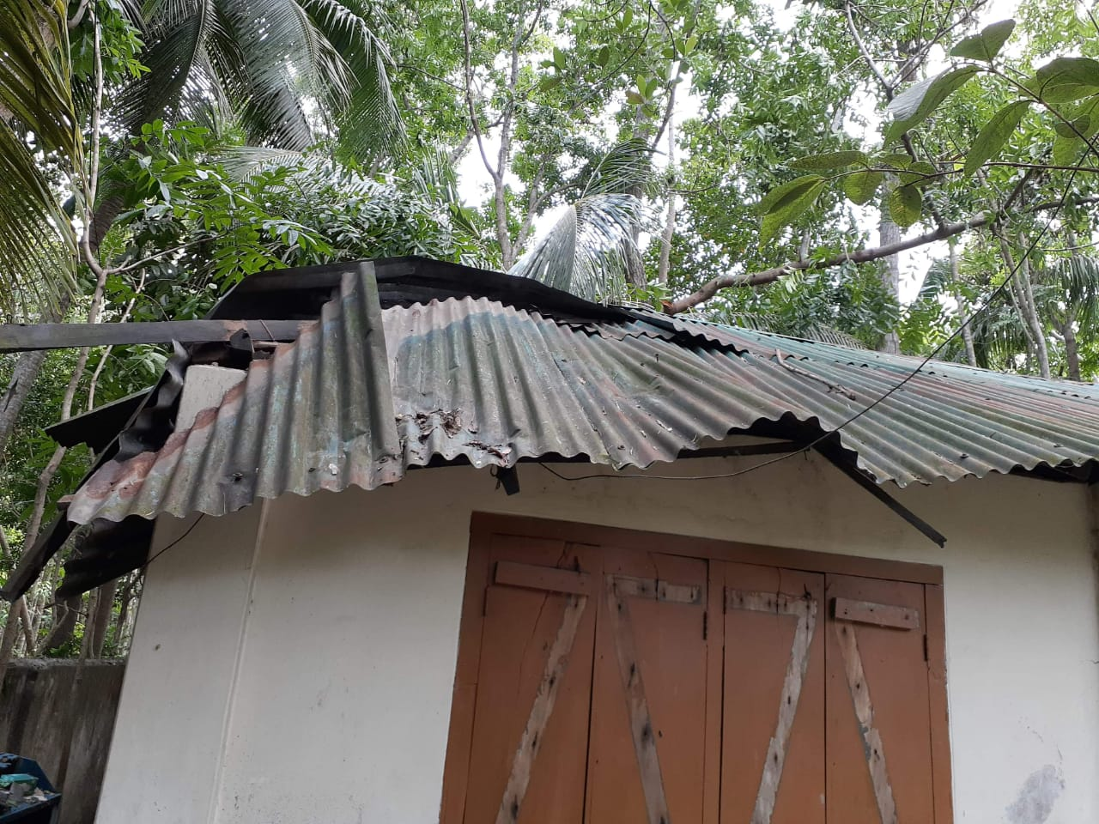
Ministry Context of Barishal Diocese:
Started its journey in 2017.
Two Deaneries & 39 churches (With 9 male priest & 14 Catechist)
Working in six districts.
Situated in the most Disaster-prone area.
Economically poor people are living in this area
Many are physically sick for various reasons.

Slide 13
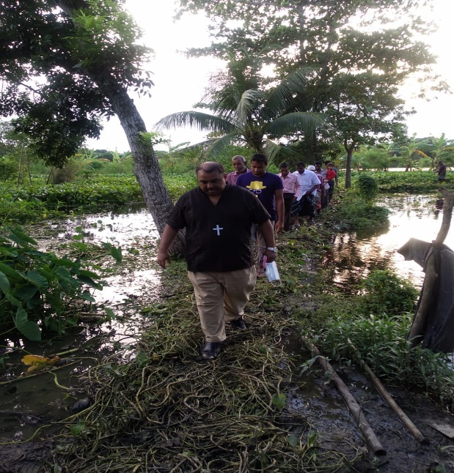
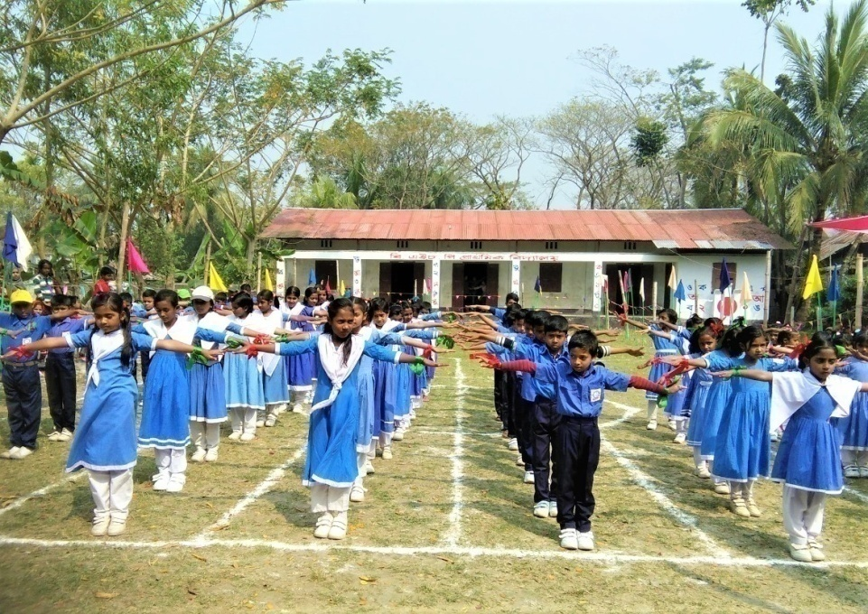
Ministry Context of Barishal Diocese:
Educated people migrated to cities. Caused leadership crisis.
Children and youth need good education and skill development
support.
Redundancy
Inequality and violence against women and children
Many have not heard the Good News.
Affected by climate change.

Slide 14
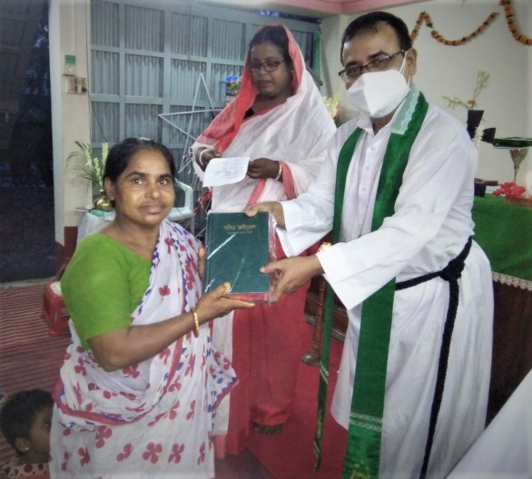
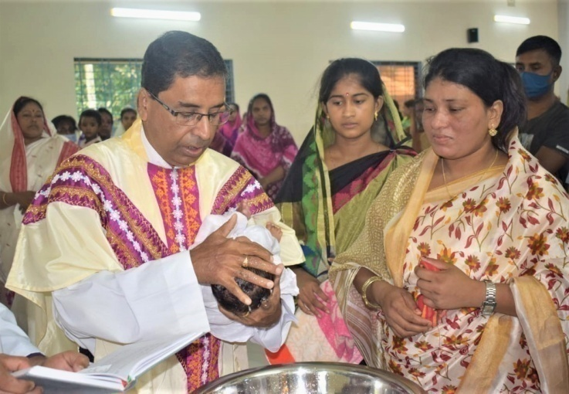
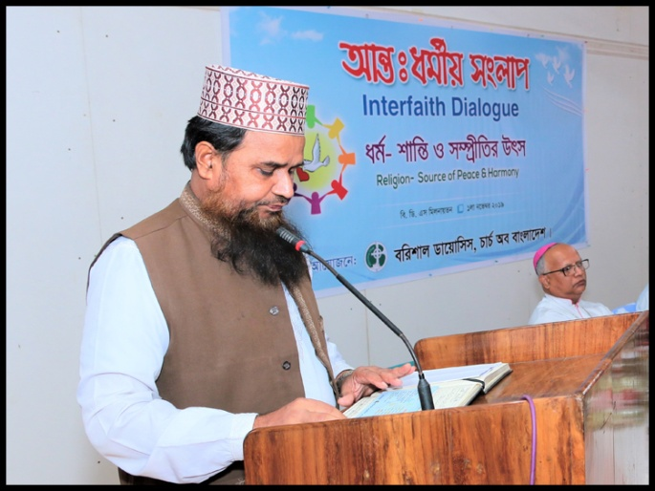
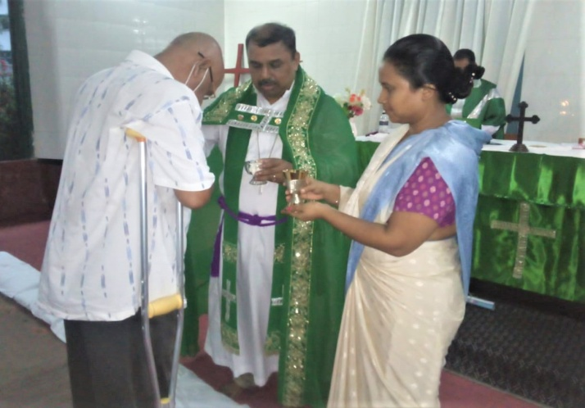
Diocesan Mission:
Provide Pastoral care to all - 39 Local parishes
Equipping servant leaders - through various life-skill training, Bible studies, seminars.
Integrating Faith and Life - Engaging people in prayer and Bible study to deepen their faith and
proclaim the God’s message of transformation and hope in changing and challenging times.
Serve, each other, the community and all creation in justice and love
Engaging and Participating - seeking to welcome the giftedness and value of each person as we journey and grow together as Body of Christ.
Reaching Out - We try to reach out to all to give generously; serve those in need; seek peace and harmony through inter-faith dialogue with our neighbor for justice and wellbeing.
Promote gender equality and empower women in the Church & Society.

Slide 15
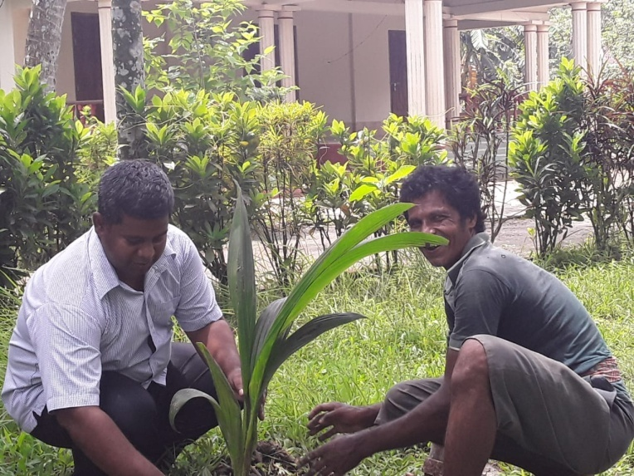
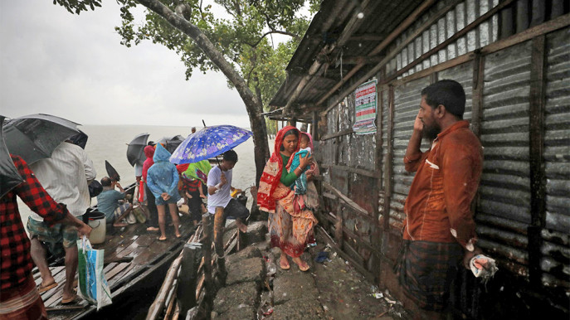
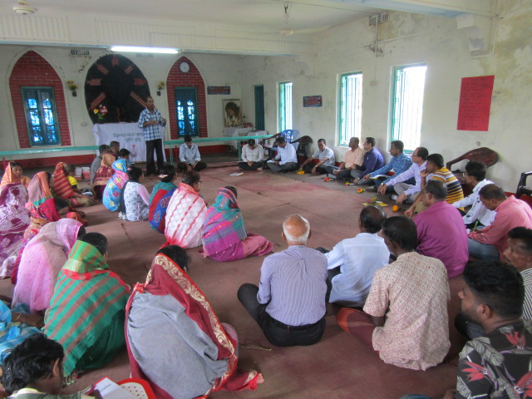
Greening Mission -To strive to safeguard the integrity of creation, and sustain and renew
the life of the earth. The diocese has local parishes where people are constantly suffering from
high salinity, river erosion, flood and cyclone.
Resilience and preparedness - Love and service expressed through sustainable lifestyle and
community living Justice and care for environmentally vulnerable people and places. A
Resilience and Church and Community Mobilization (CCM) workshop has been given priority to
increase community cohesion, diversified livelihoods, land management, infrastructure, human
capital and shared analysis with the stakeholders.

Slide 16
COB Ministries
Education
Golden Age
Health
Women Fellowship
Church of Bangladesh
Children & Adolescent
Youth Fellowship
Social Development
Integral Mission
Sisterhood and Fatherhood
Publication
Theology & Liturgy
Evangelism, Ecumenism

Slide 17
Opportunities and challenges of mission for the Church of Bangladesh within the current context
Opportunities:
Vast mission field. Many ways to do mission work.
Partners like USPG are involved with us to continue mission work.
We have infrastructures to continue education and health services all over the Bangladesh.
Churches are scattered all over the Bangladesh, which is a blessing to reach out to many with Gospel.
Challenges:
Big number of people including our church members have lost their jobs and the means of livelihoods are being compressed.
Financial supports from the foreign mission partners and development partners are being declined.
Necessity of health services and mental stress in COVID-19 is increasing day by day.
Providing salaries to teachers & staffs while the educational institution have no income
Shifting peoples’ mentality from Relief to Resource.

Slide 18
Prayer points
Remember the nation Bangladesh as it struggling to cope with COVID19 situation
The church remain faithful to its calling for the people amid negative environment
The church find resources to support people to secure their livelihood and flourished.
Pray for the integral mission of the church through its various wings, staff may remain positive
and healthy as they encounter many in the process of rendering services.
May our Children and Youths have patience to endure this time of restriction and continue
their education in the safest way.
May our women and men understand their God given talents and use it for the love of Christ.
People living in the most endanger areas where they face the climate change impact regularly
be resilient and safe.
May the church be bold enough to take its prophetic role seriously.

Slide 19
Thank you for your patience hearing
Dhanyabad.

