Slide 1
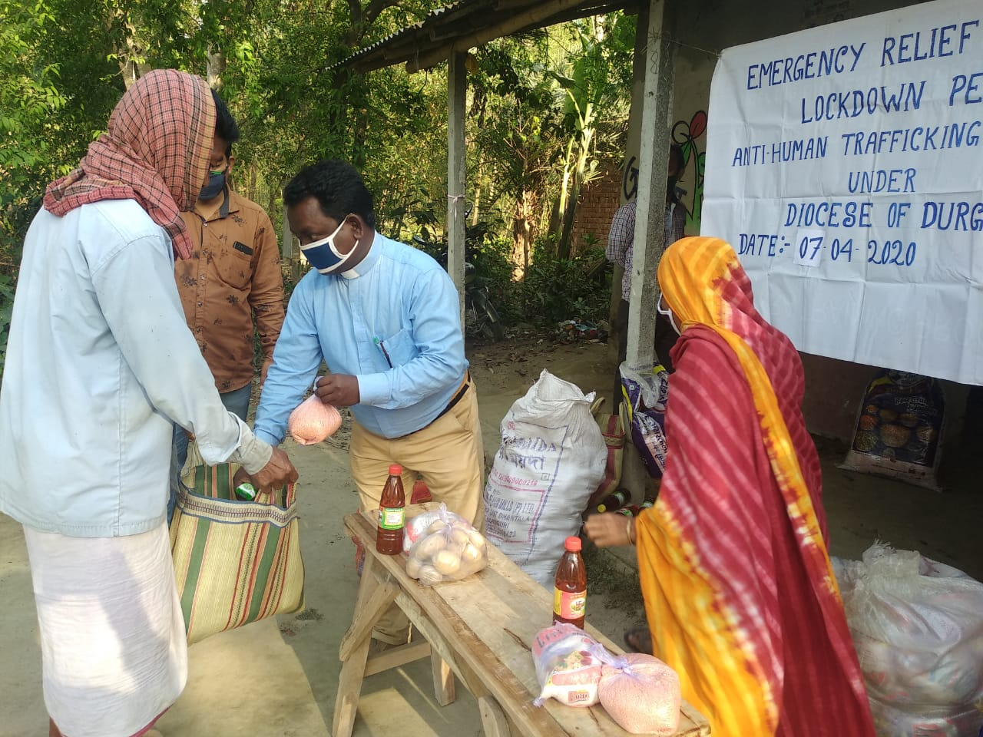
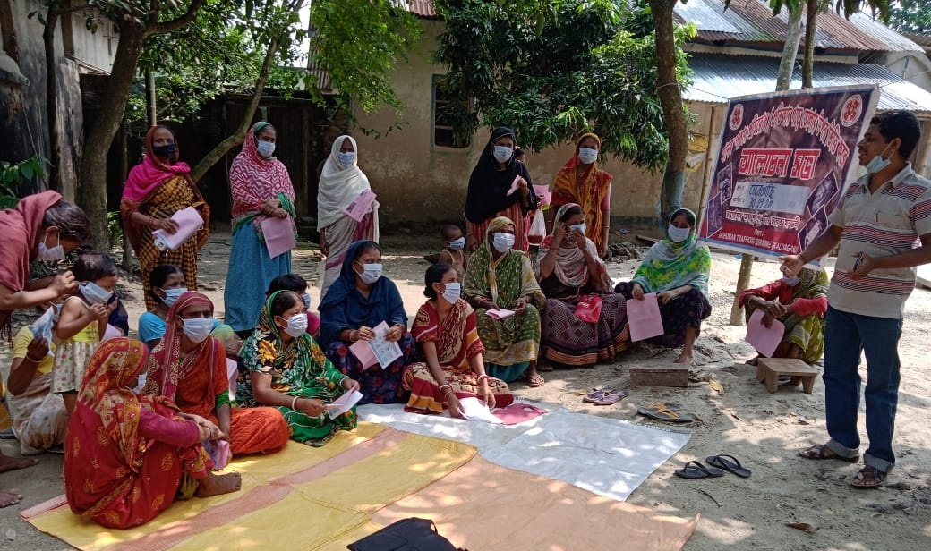
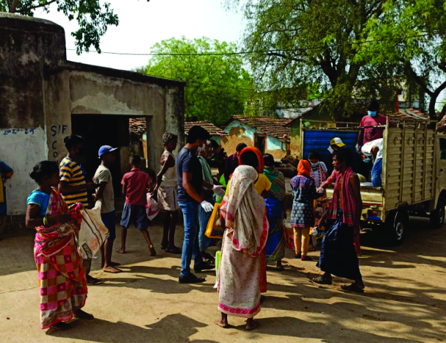
AHT Efforts: During the Pandemic
Diocese of Durgapur (CNI)

Slide 2
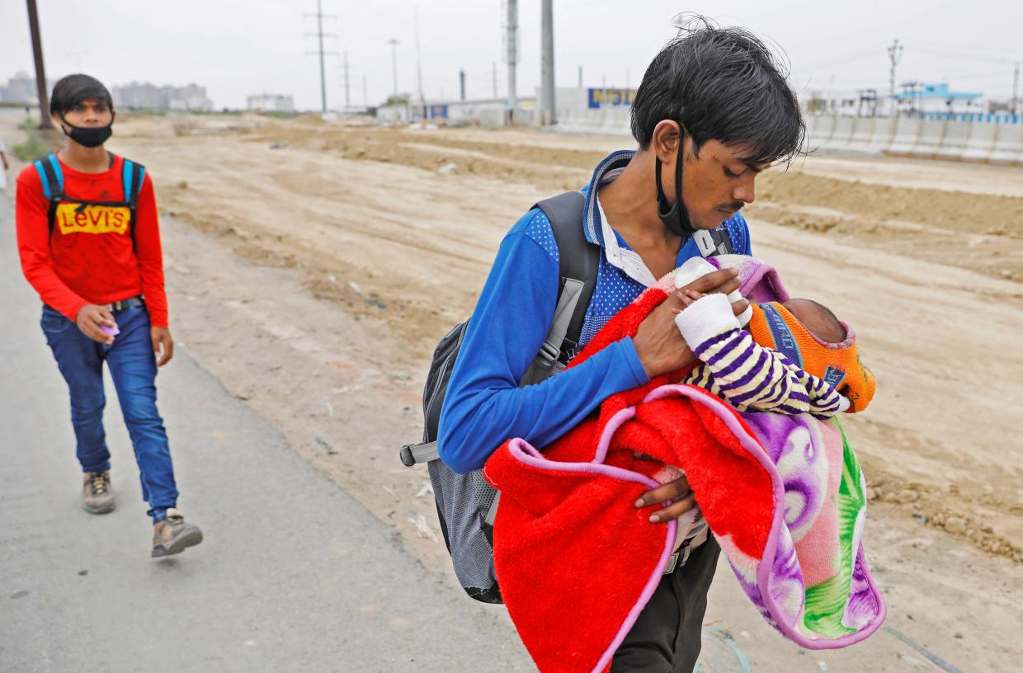
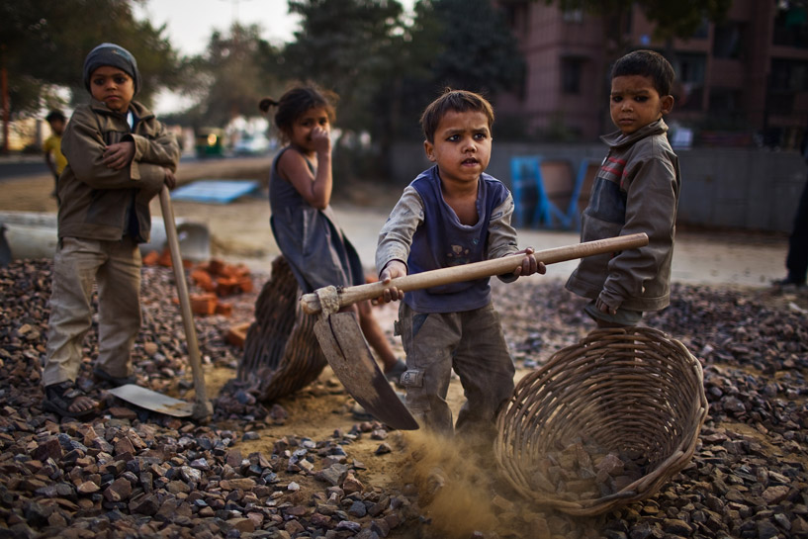
India’s Crisis
The Pandemic has had many repercussions in India
Migrant labourers all over India have lost their jobs and many have died
The Economy took a hit with the largest drop in GDP of 23.9%
Massive unemployment
Reverse migration in hopes of employment
FMCG, Micro Small & Medium Enterprises, & even agriculture suffered adversely
India slipped 10 places to 51st position in the 2019 Democracy Index's global ranking due to the "erosion of civil liberties”

Slide 3
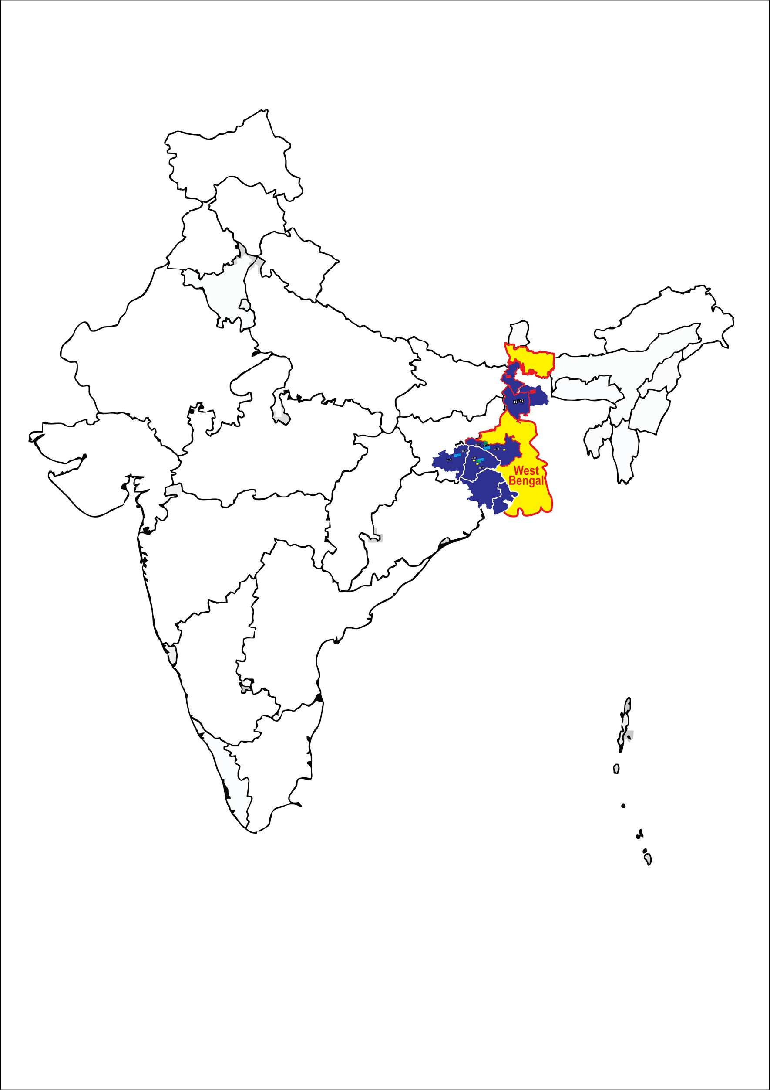
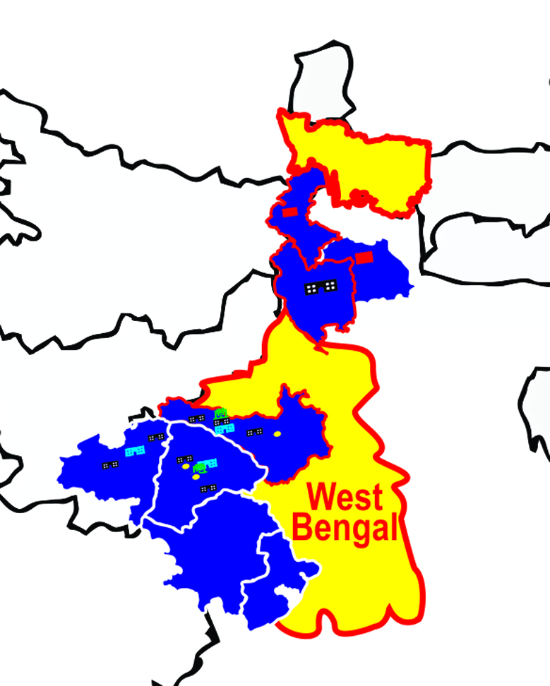
Present situation in the Diocese
The Diocese is currently slowly reopening its church doors.
The Diocese is also picking up in terms of activity trying to create a balance of online and offline
Focus is on supporting and strengthening what needs buffering

Slide 4
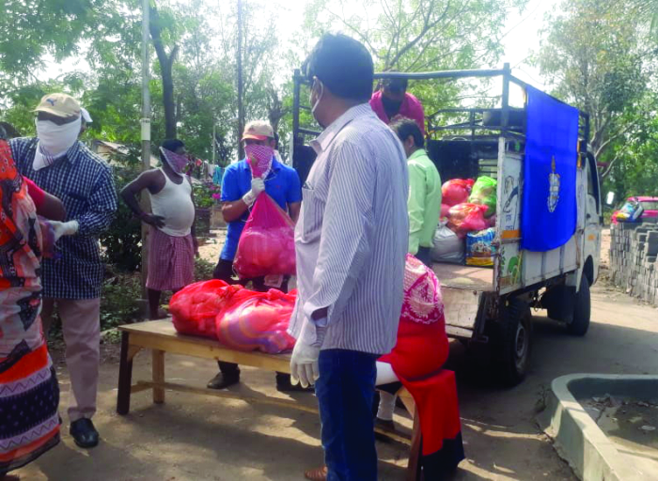
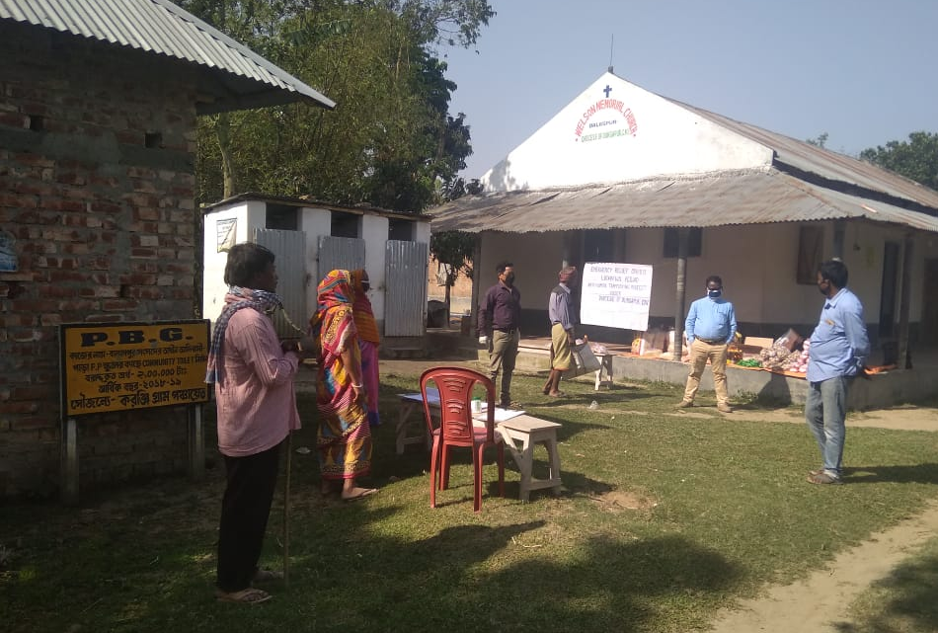
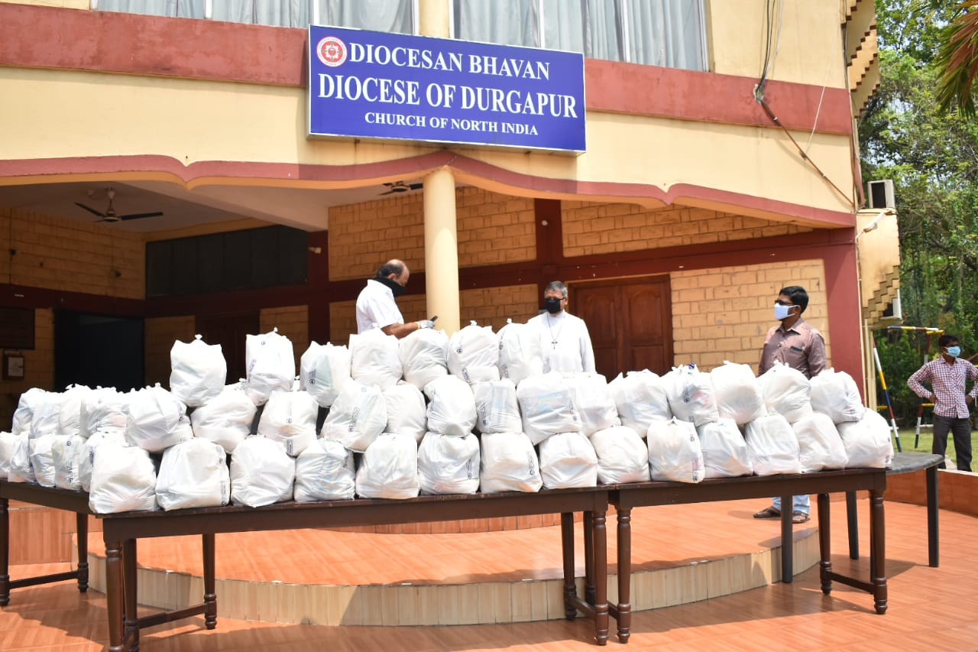
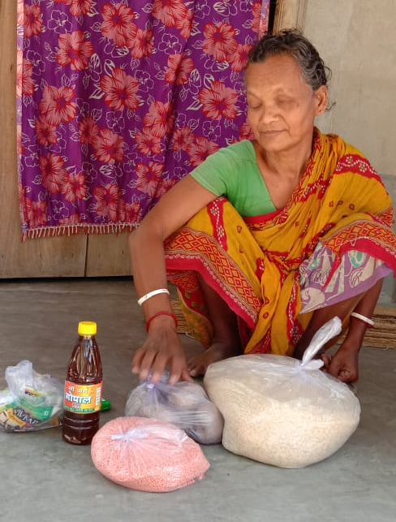
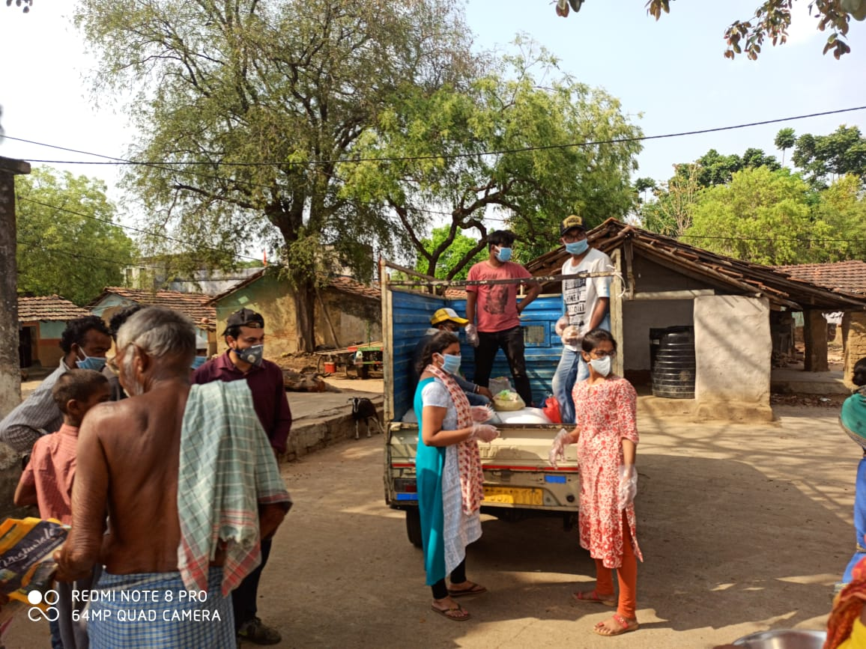
Response of the Diocese to Covid

Slide 5
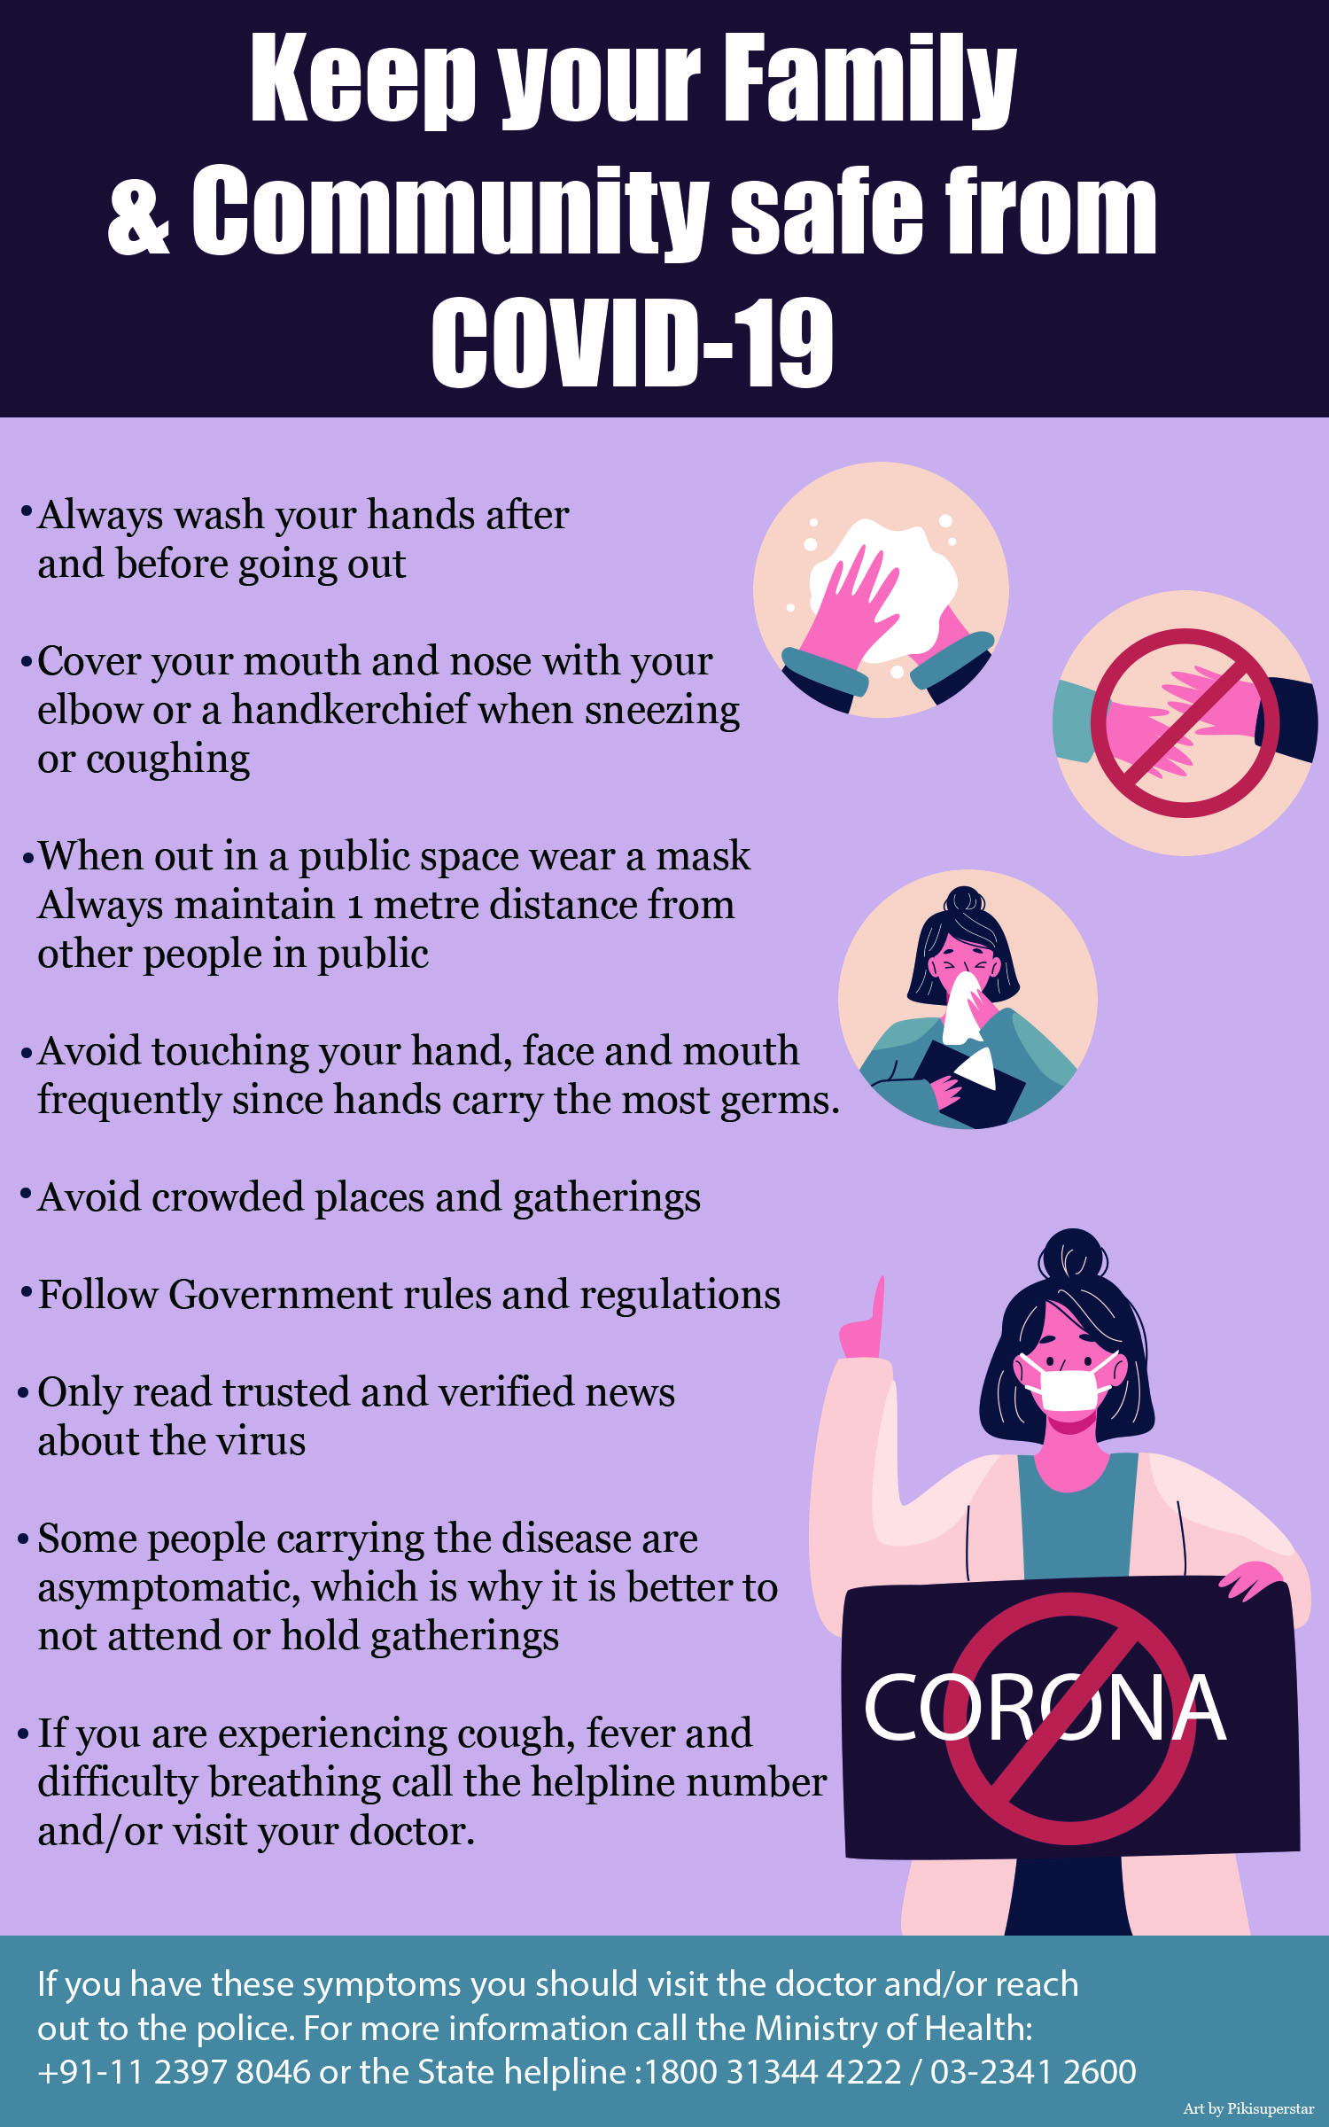
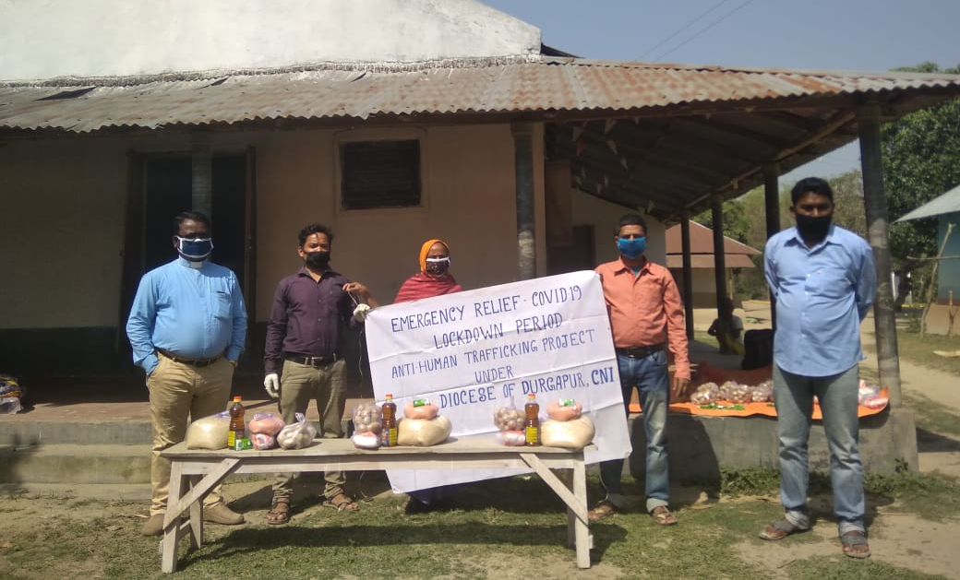
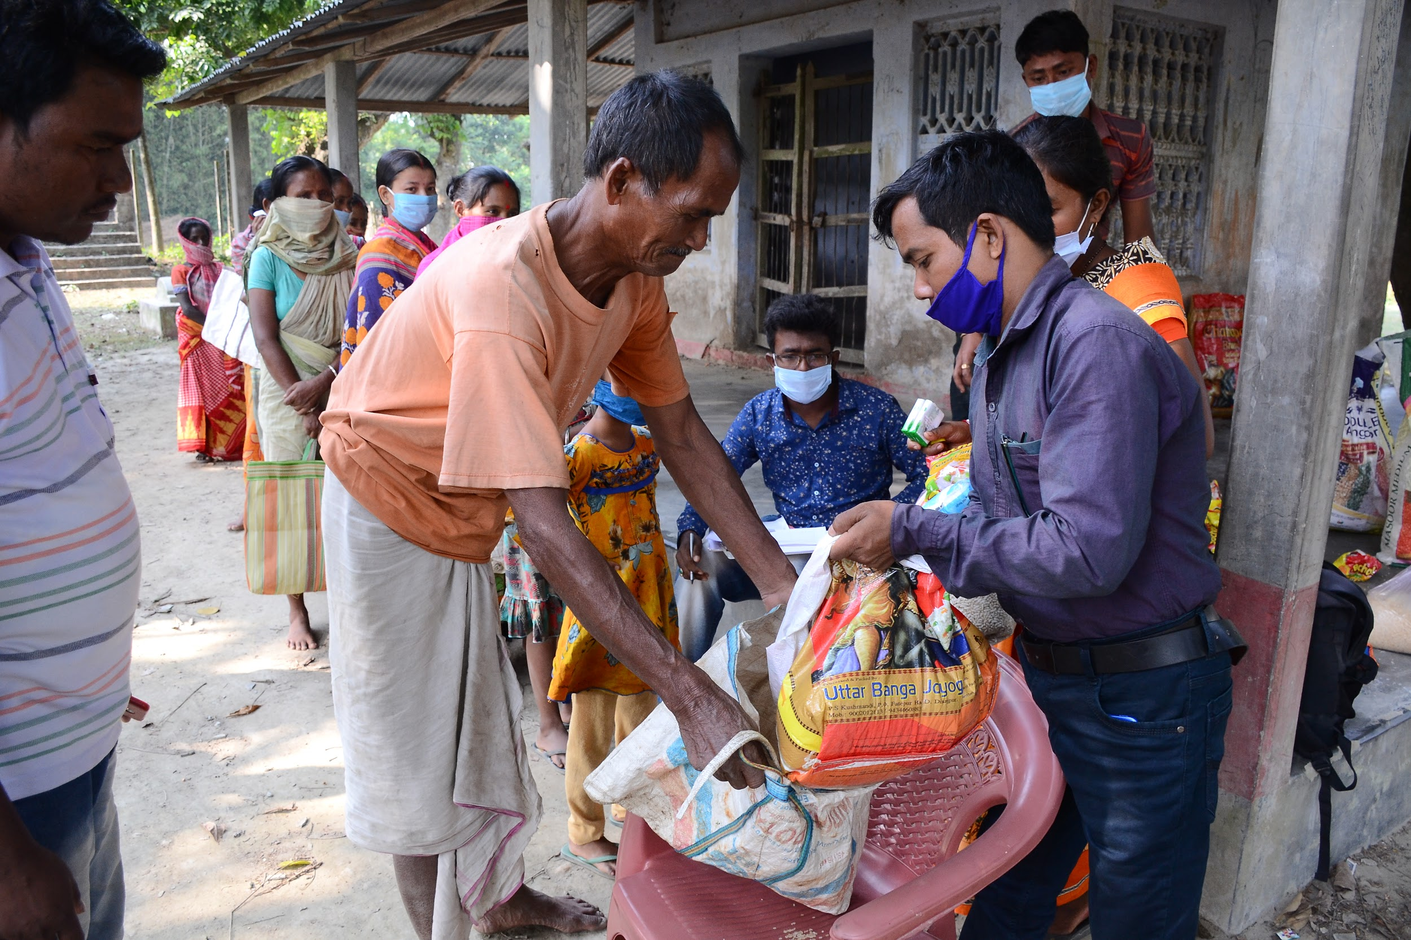
Response to rising cases of trafficking
News reports state that there is a rise in human trafficking
The AHT team decided to
Have smaller but more frequents gatherings
Spread awareness on Covid
Focus on the precautionary measures necessary if travelling

Slide 6
Collaborations with other organizations
and:
Bondhan Dal
IMC in Kunur
Legal Cells

Slide 7
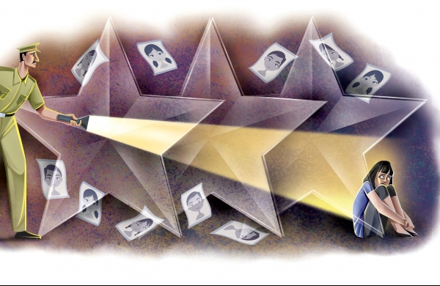
Response by the government
This period has revealed the weaknesses within the system set up by the government to prevent human trafficking. To strengthen and revitalize the existing Anti-Human Trafficking Units (AHTUs)

Slide 8
NGOs dont get a lot of support
Lack of Sufficient Manpower
CHALLENGES
Not high on the list of priorities for the Government
Reverse migration for Jobs
Elopements and Child-marriages have become an option

Slide 9
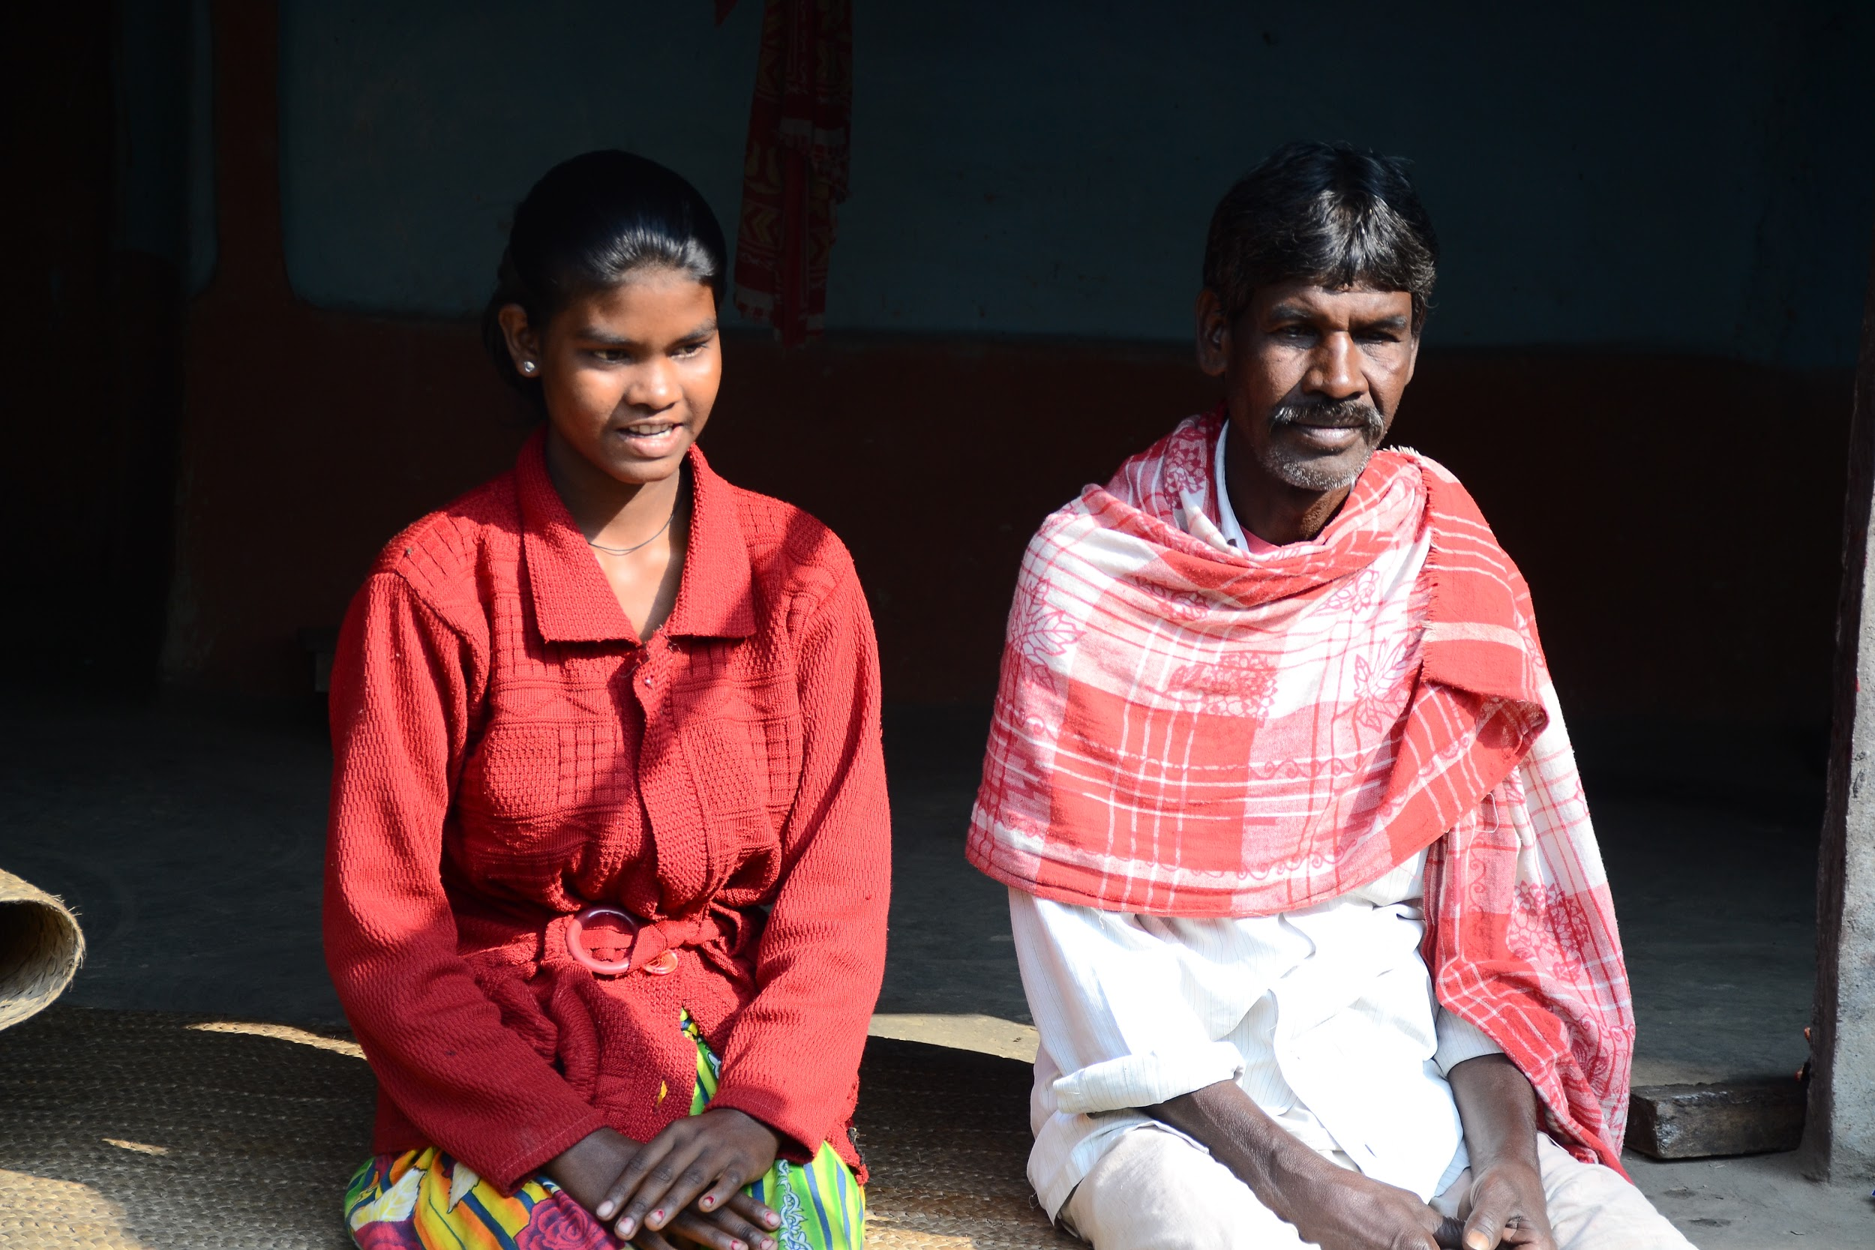
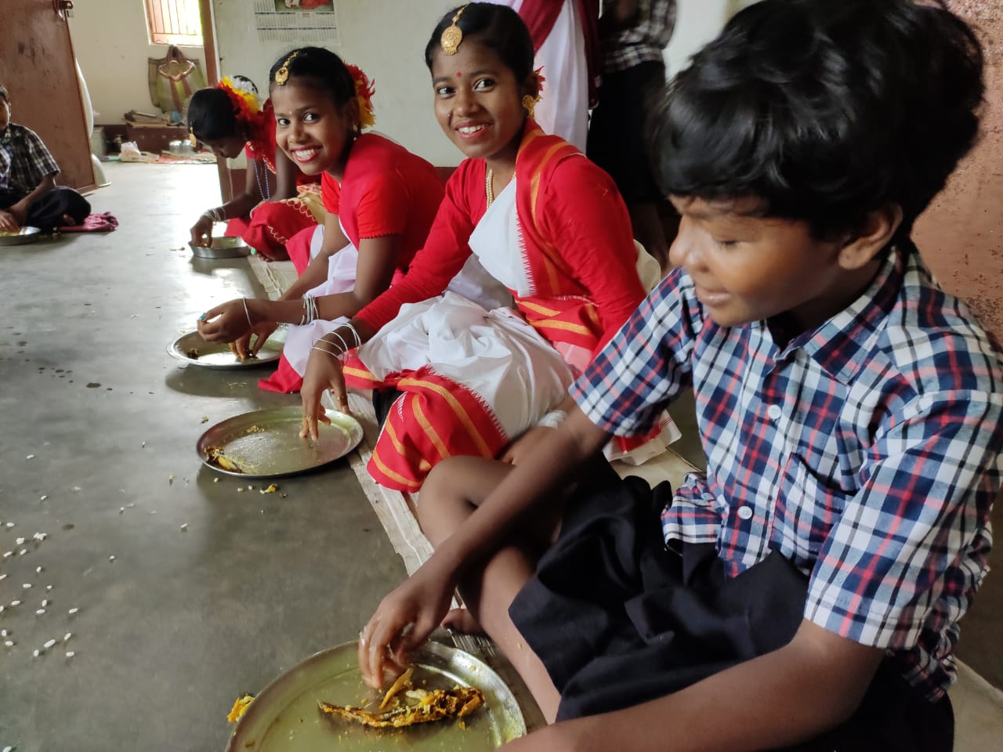
Opportunities & Lessons
To become the first responders
To build reputation and network across the state and slowly the country
To create footholds within communities which become deterrents for traffickers
Create safe spaces for at risk and/or trafficked children

Slide 10
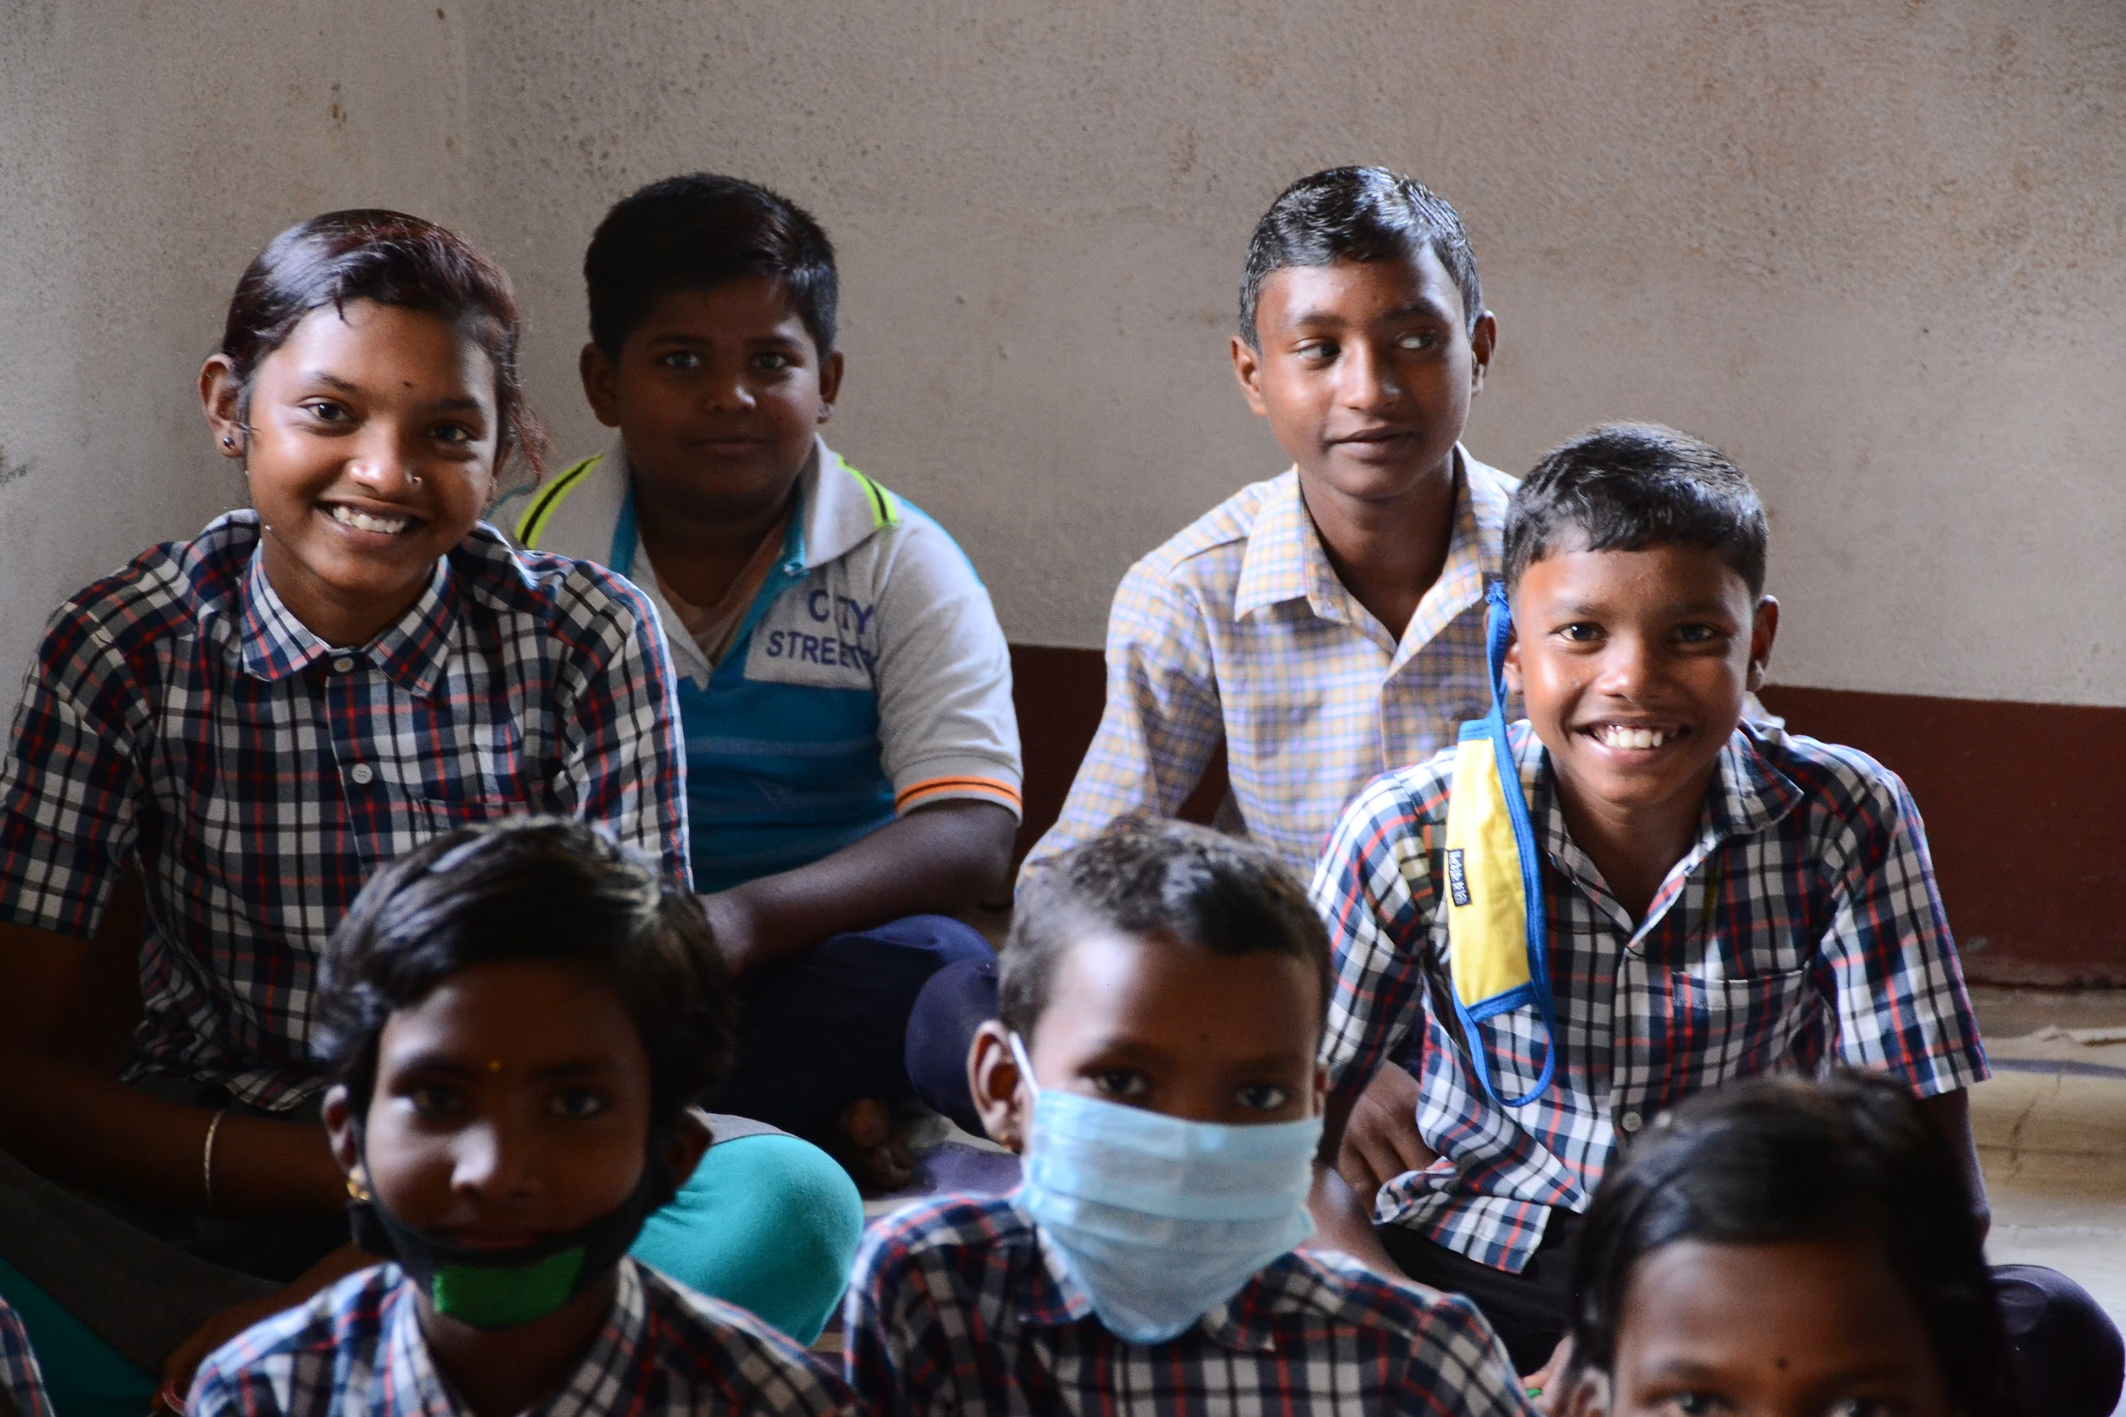
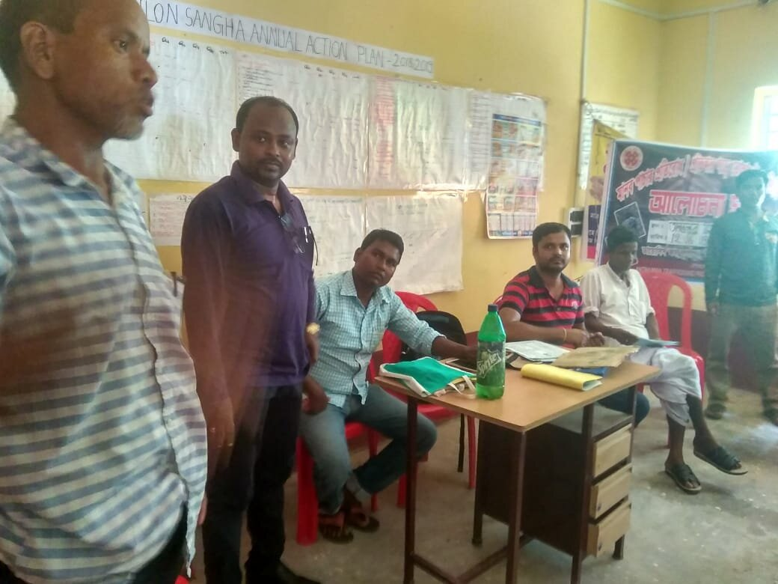
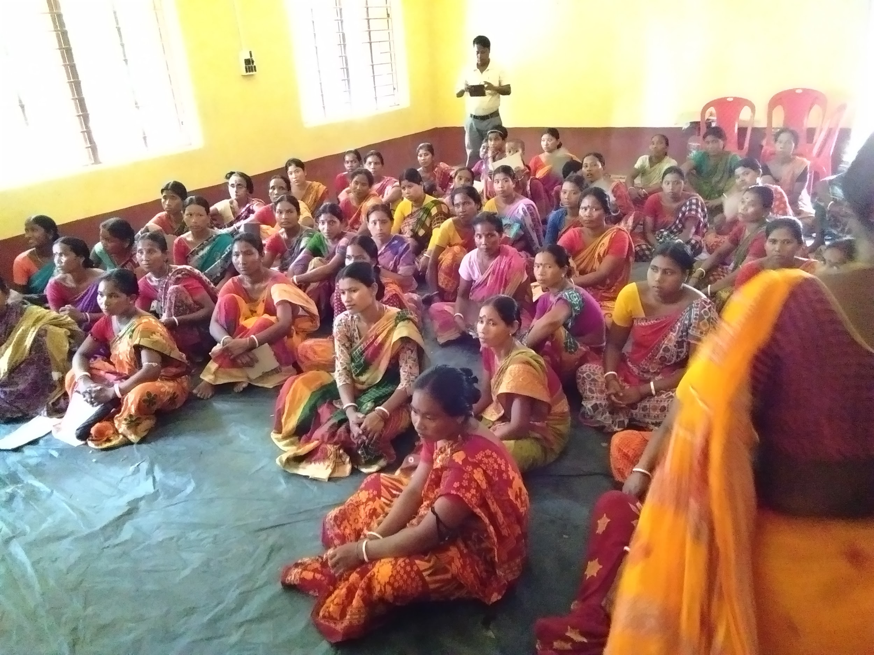
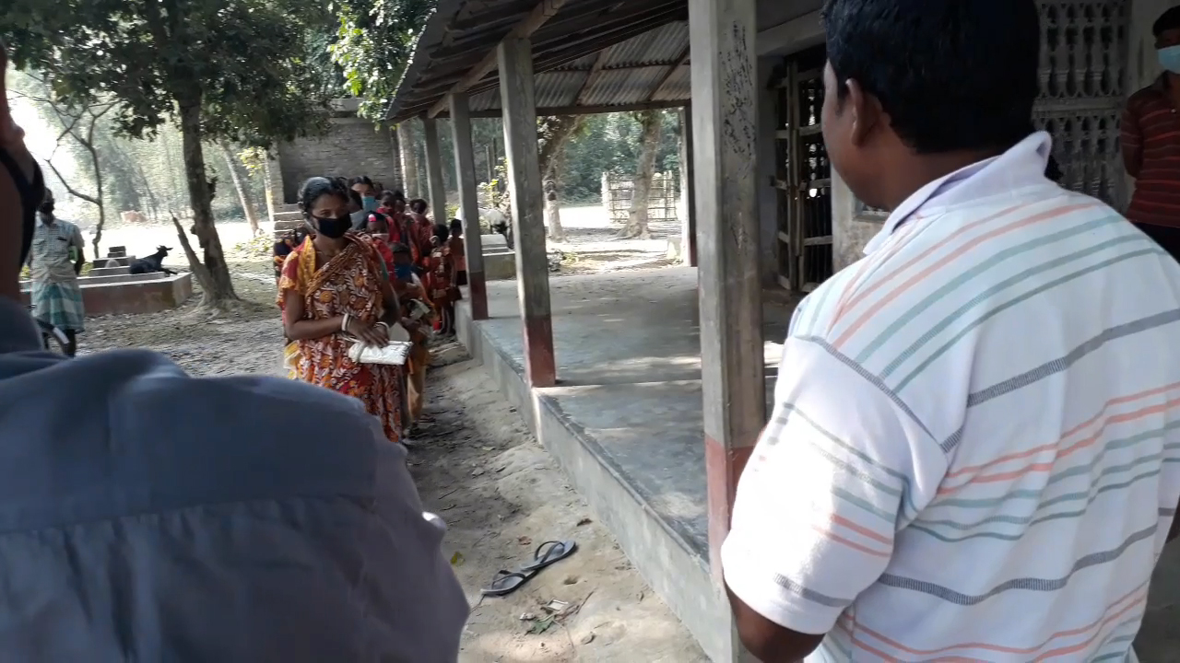
Resources & Tools
Lessons learnt on the field
With officials
With victims
Best methods of connecting with a rural audience

Slide 11
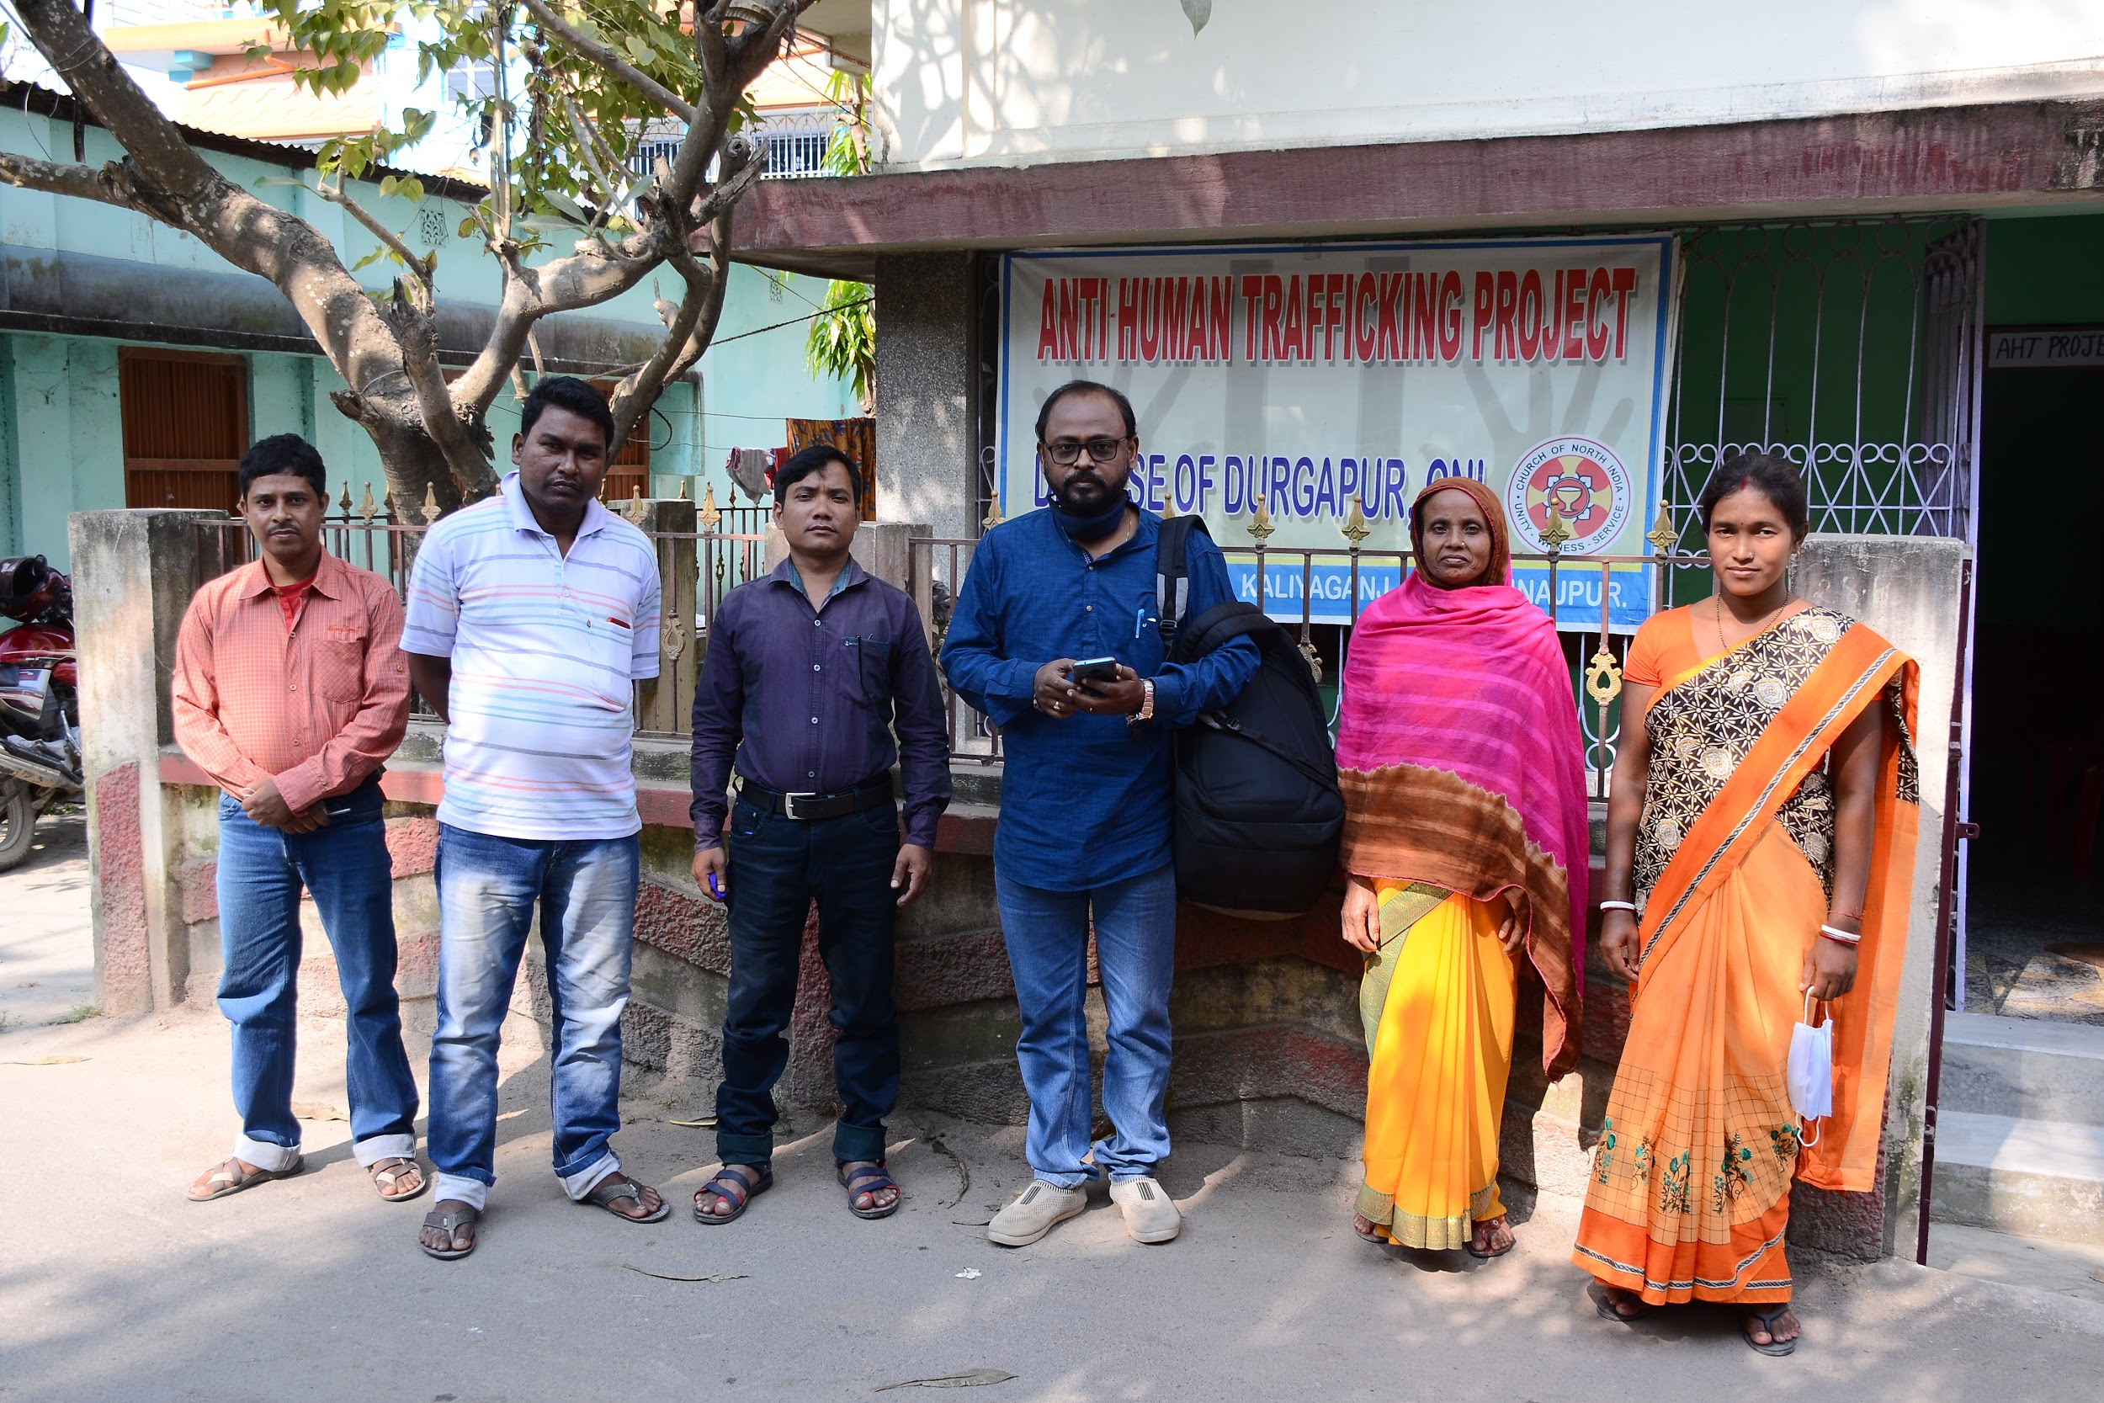
Global, National, & Regional opportunities
Increase the size of the team and work in the other districts of the diocese and more
A battery operated projector for some awareness programmes
More workshops and to improve skills
Help in creating connections to improve our network and be more effective

