Slide 1
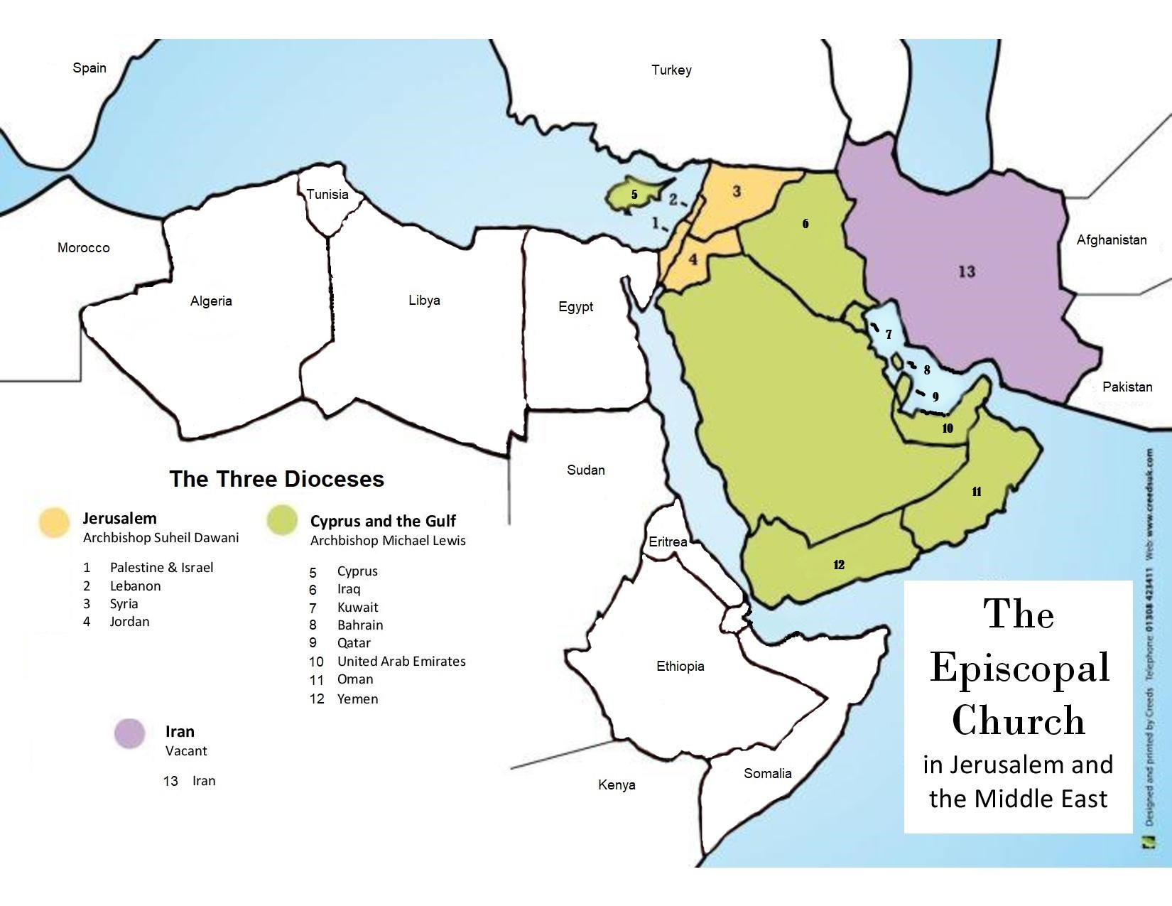
Diocese of Cyprus and The Gulf

Slide 2
Human Trafficking: some facts
4.2 per 1000 population - some 5,000 people are trafficked
19.12 per 100 are vulnerable - some 222,000 people.
(Global slavery index 2018)
in South, 801 presumed trafficked from 2015-19
Only 24% of these were formally identified
80% were female
Of these women:
70 were sexually exploited;
37 forced into marriage
11 exploited for labour
25 combination of above
All males exploited for labour
7 children trafficked for begging
(2020 data GRETA)

Slide 3
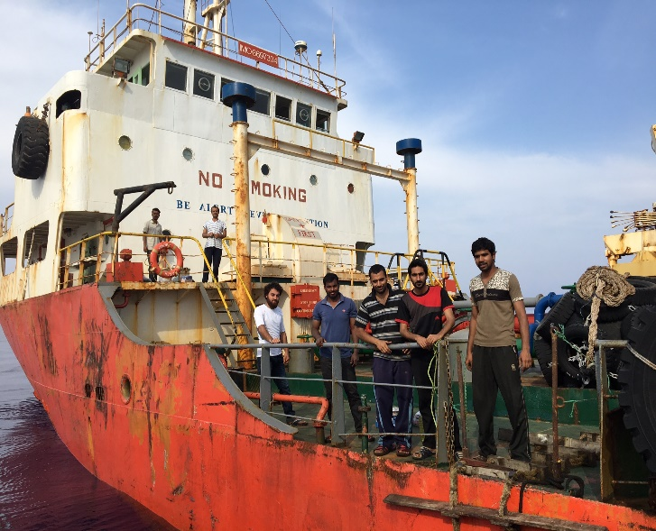
Who is vulnerable?
Domestic victims identified over past 5 years
Cypriots addicted to drugs
Young women with disabilities
Key foreign groups
Asylum-seekers and refugees
Migrant workers
Students
Tourists on short-term visas
Abandoned seafarers
(US Dept. of State 2020 Trafficking in Persons Report: Cyprus)

Slide 4
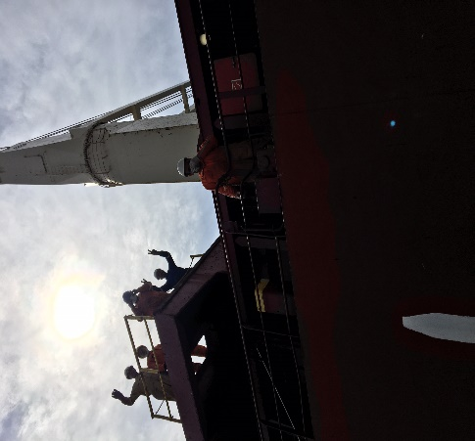
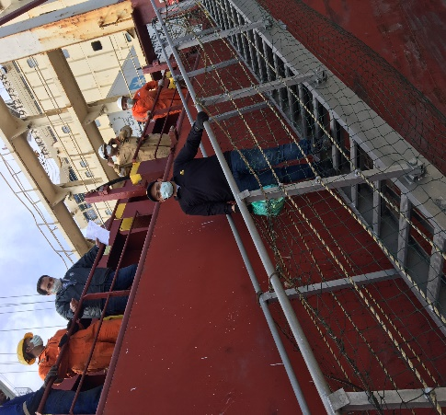
Impact of Covid-19
Vulnerability of key groups exacerbated in terms of:
Difficulty in accessing government information ,healthcare, legal assistance, education
Greater administrative delays
Financial insecurity and poor living conditions
…. But there is some good news too…

Slide 5
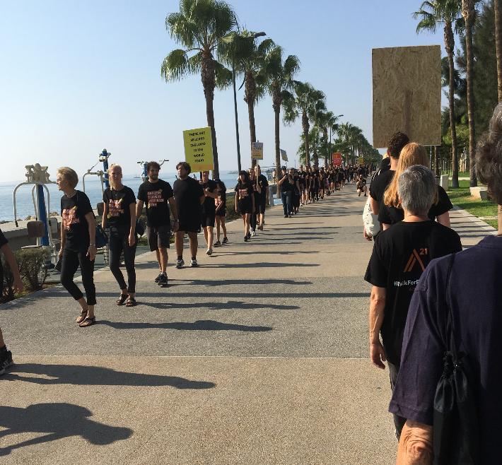
Churches’ responses: Prevention
Increase awareness and knowledge of church communities
Opportunities to witness solidarity
Preaching and teaching
Written briefings
Increase awareness and knowledge of vulnerable individuals as appropriate

Slide 6
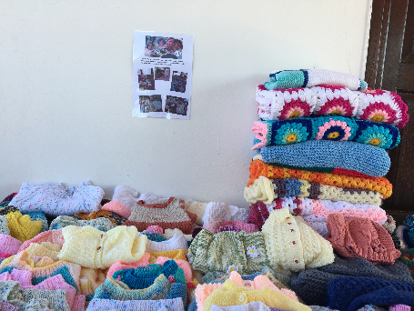
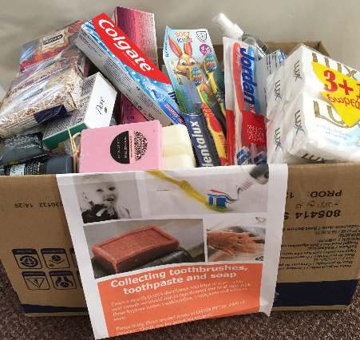
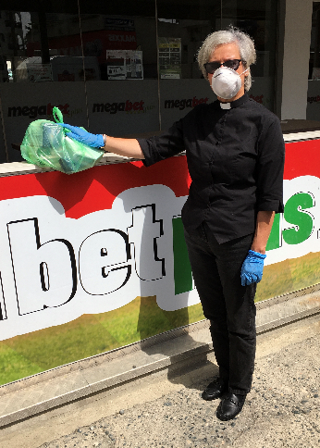
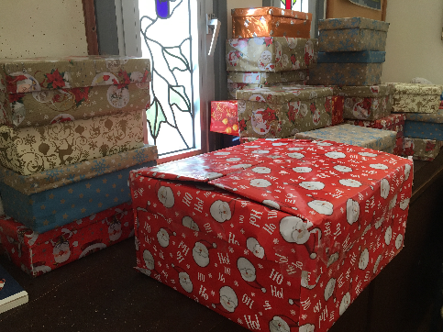
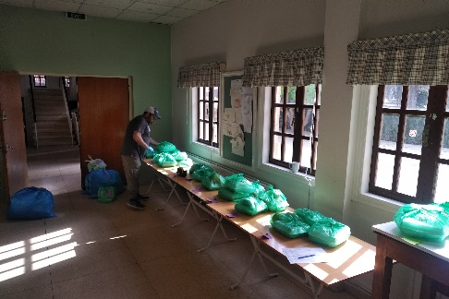
Churches’ responses: Protection
Welcome and hospitality
Inclusion and valuing of their gifts
Individual advice and advocacy
Emotional and practical support
Specific initiatives before and during the pandemic

Slide 7
Churches’ responses: Partnership
Partnering with:
Anglican Alliance
Local Non Government Organisations
Other Christian denominations and faith groups
Local municipalities
Hosting:
Pan-island Annual Social Outreach Forum
Locality group support and action
Supporting ongoing research programmes
Planning safer migration workshop

Slide 8
Churches’ responses: Prayer
Ministry of pastoral accompaniment
Sharing worship and Bible study as fellow Christians
Being a ‘Hothouse of prayer.’

