Slide 1
Gardens of life
USPG Sermon for Harvest 2021

Slide 3
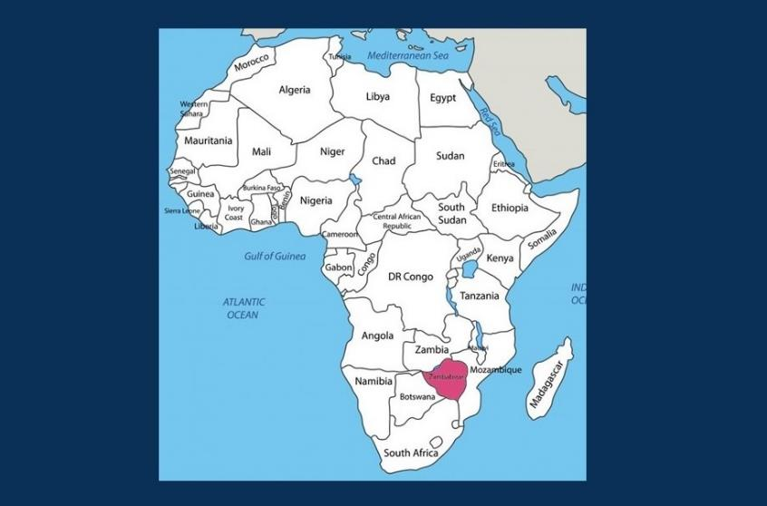

Slide 5
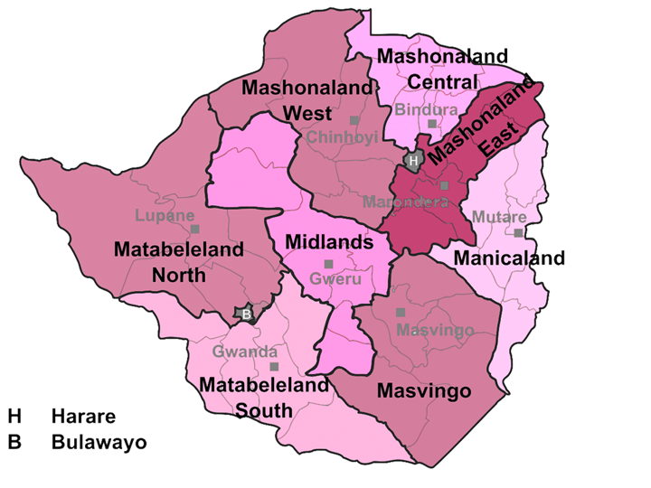

Slide 6
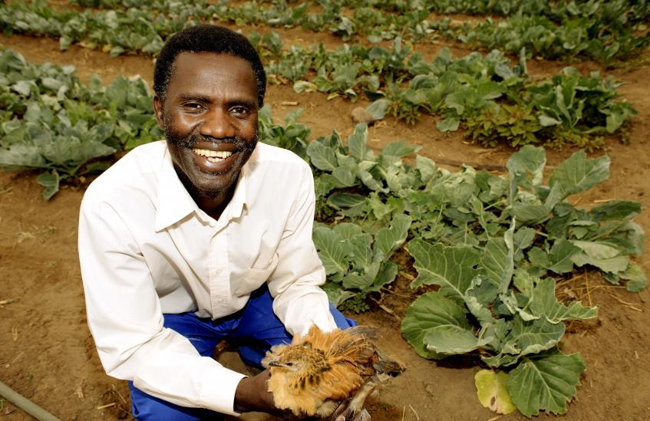

Slide 7
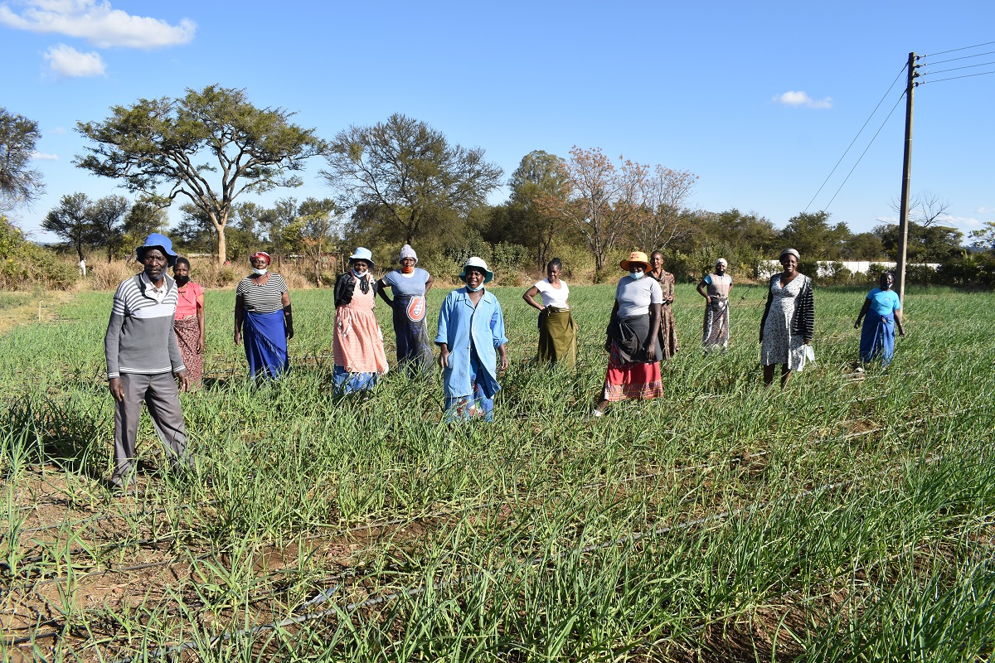

Slide 8
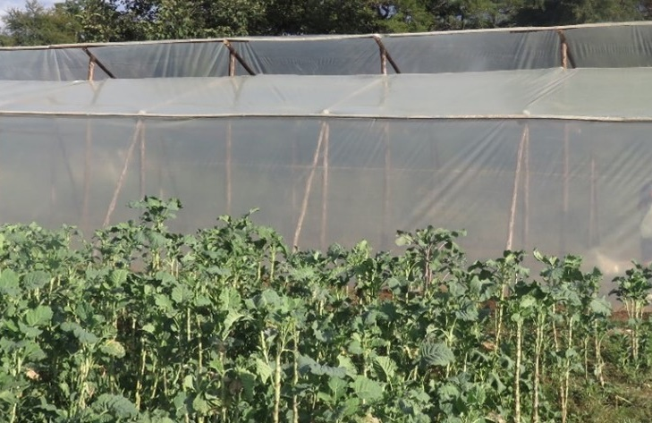
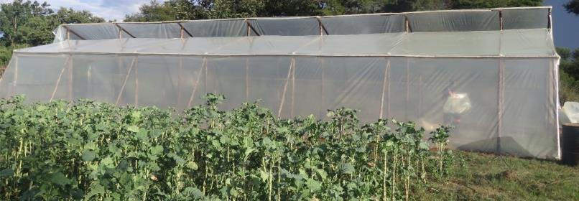

Slide 9
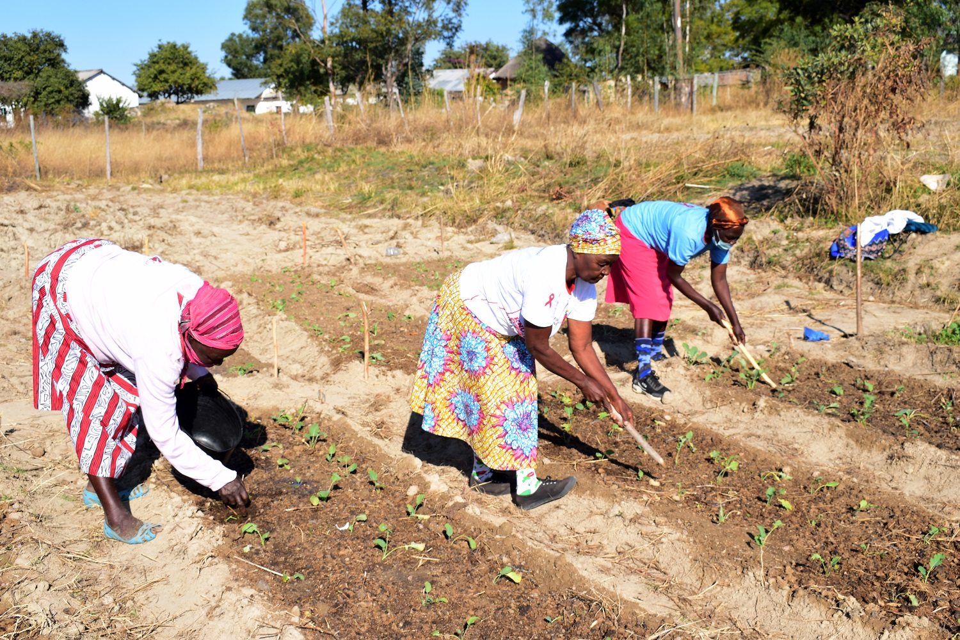

Slide 11
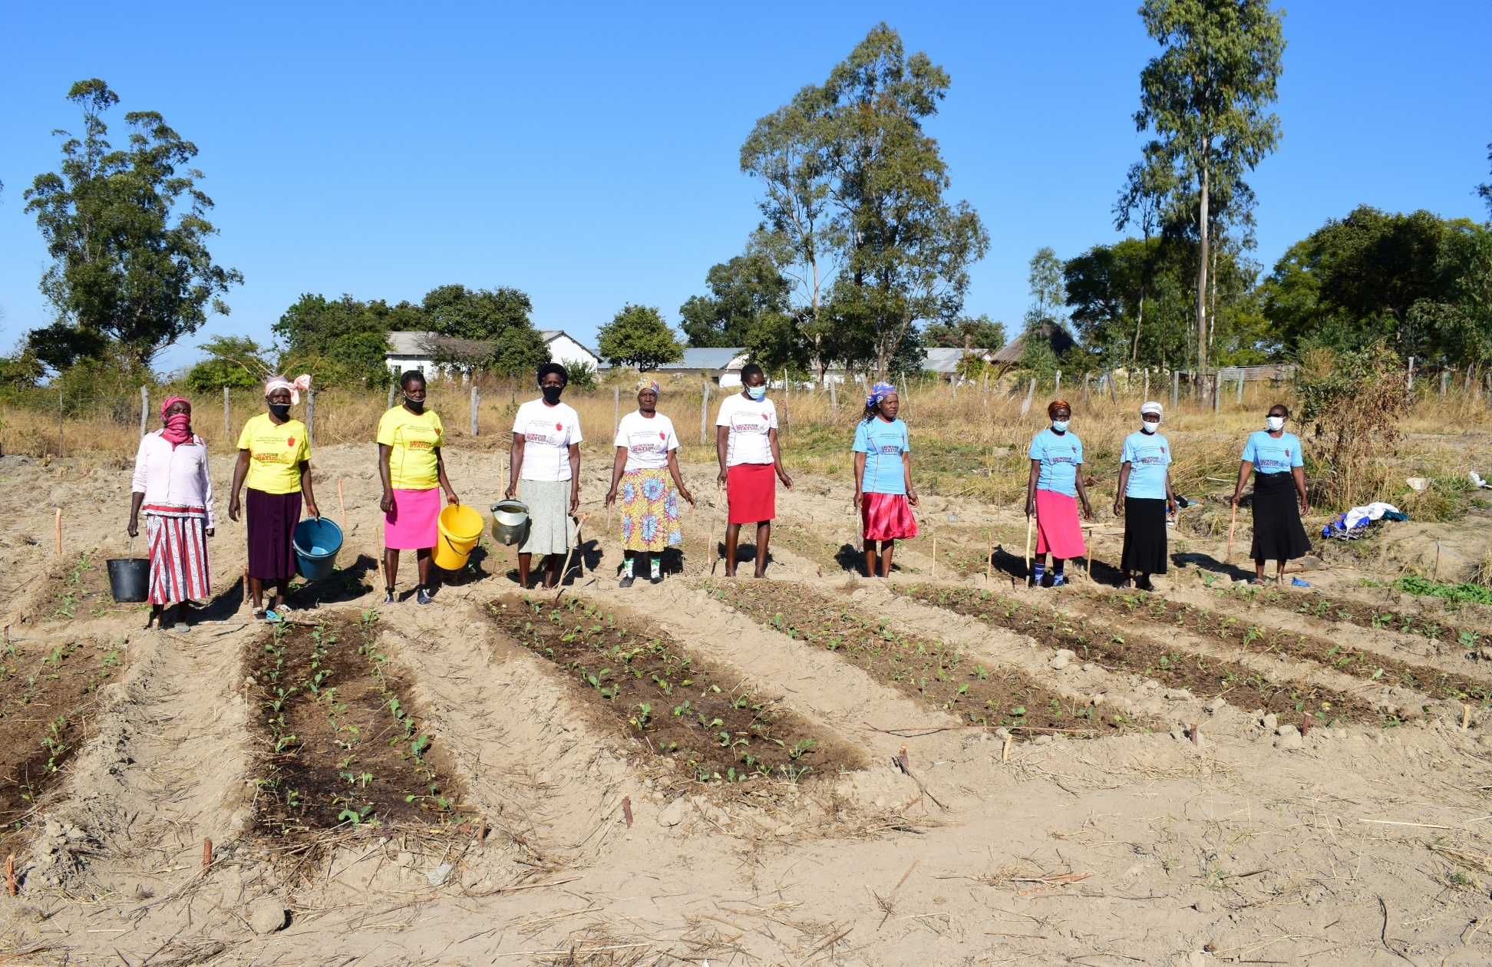

Slide 12
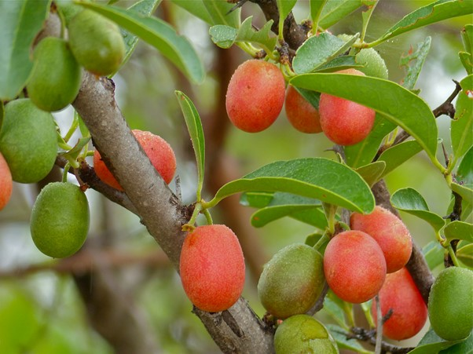

Slide 13
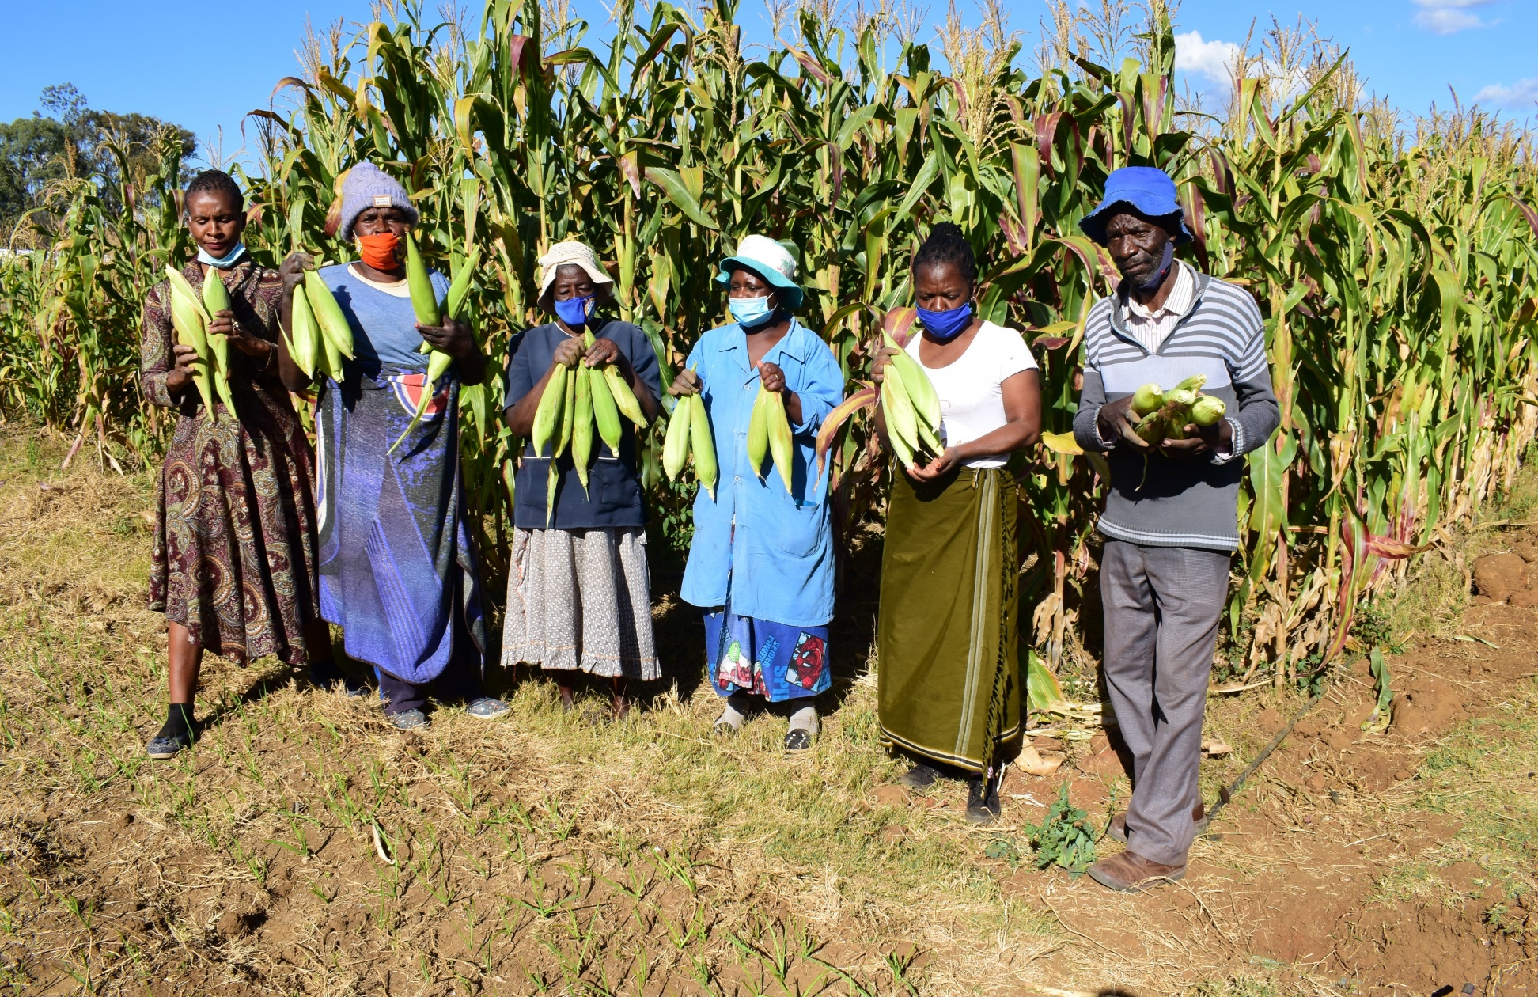

Slide 14
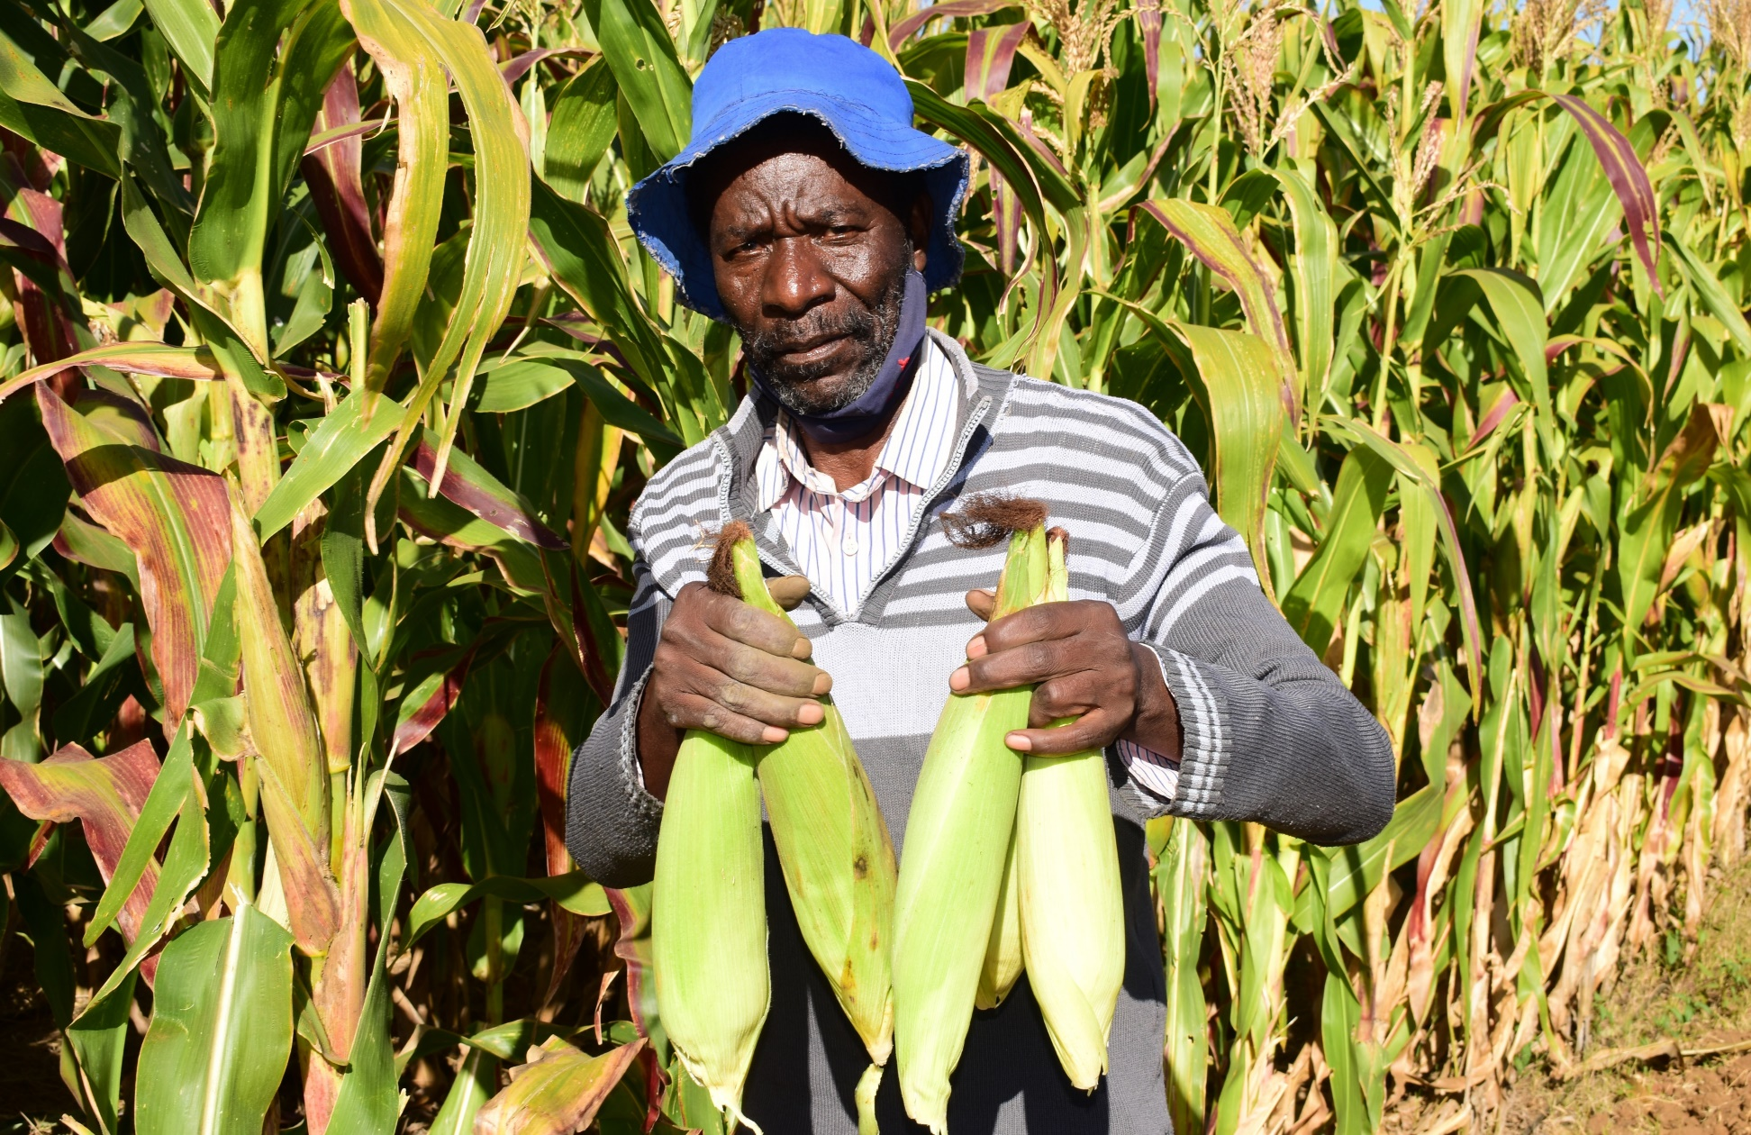

Slide 16
£35 would pay for tools to make fencing
£60 would pay for essential equipment such as shovels and hosepipes
£140 would pay for grafted trees
£350 would pay for seeds and organic manure

Slide 17
Lord of the harvest, thank you for all you have given us.
Help us to share our abundance with those across the world this harvest-time,
And work together to protect the most vulnerable and your creation,
That all may share in the provision of your gracious harvest. Amen.

Slide 18
Donate now at www.uspg.org.uk/harvest
or call 020 7921 2200
Thank you
USPG
5 Trinity Street
London SE1 1DB
020 7921 2200
info@uspg.org.uk
www.uspg.org.uk
Founded 1701
President: The Archbishop of Canterbury
Registered Charity Number 234518

